Slide 1



Workshop on Connecting Concepts Across the Curriculum
Goals and Methods

Slide 2
Main Goal
Teach important ideas in a distributed way throughout the curriculum
Rather than operate courses as concept islands
Any new activity in a course (besides helping courses downstream)
Must not be disruptive to the course
Should even be beneficial to the course
Workshop on Connecting Concepts Across the Curriculum

Slide 3
Main Goal
Target Courses
Digital Logic
Programming
Microprocessors
Embedded Systems
Computer Networks
Computer Organization and Architecture
Algorithms
Identify important recurring “topics” in a curriculum
For a topic, identify a “thread” of its manifestation across courses
For a thread, identify “methods” to explore it across courses
Workshop on Connecting Concepts Across the Curriculum

Slide 4
Identifying topics
Your suggestions in a matrix as a starting point
Abstract thinking
Memory
Folder has copies
Alphabetical
By “density”
Workshop on Connecting Concepts Across the Curriculum

Slide 5
Threads abstraction memory
Digital Logic 1 + 1 = 1 state, circuit
Programming flowchart to code variables
Microprocessors binary string LUTs, RAM, ..
Embedded Systems context
Computer Networks layers connection state
Organization and ISA hierarchy
Architecture
Algorithms models of comp. Online, oblivious
Workshop on Connecting Concepts Across the Curriculum

Slide 6
Threads abstraction memory
Group indicated in folder
Digital Logic 1 + 1 = 1 state, circuit
Programming flowchart to code variables
Microprocessors binary string LUTs, RAM, ..
Embedded Systems context
Computer Networks layers connection state
Organization and ISA hierarchy
Architecture
Algorithms models of comp. Online, oblivious
Workshop on Connecting Concepts Across the Curriculum

Slide 7
Session 1: Topics
One table per group
Select 10-15 important and difficult topics
Keep thread in mind
Merge topics from all groups
Workshop on Connecting Concepts Across the Curriculum

Slide 8
Session 2: Threads
Groups are mixed
Group leaders stay at same table
Identify threads across topics
Select 5-10 threads per table
Reconcile threads across tables
Workshop on Connecting Concepts Across the Curriculum

Slide 9
Session 3: Teaching
Groups are mixed again
Group leaders stay at same table
Identify methods to teach threads
Compile teaching methods
Workshop on Connecting Concepts Across the Curriculum

Slide 10
Session 4: Results and Feedback
Compile results
Conclude
Workshop on Connecting Concepts Across the Curriculum

Slide 11
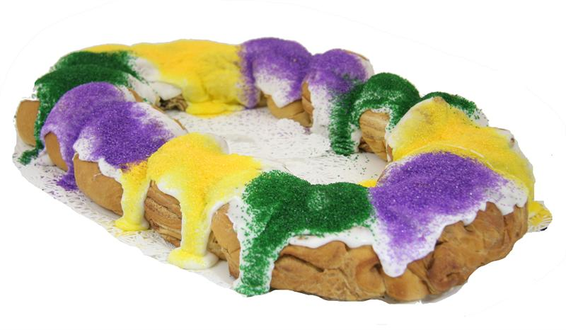
Questions?
Workshop on Connecting Concepts Across the Curriculum

