Slide 1
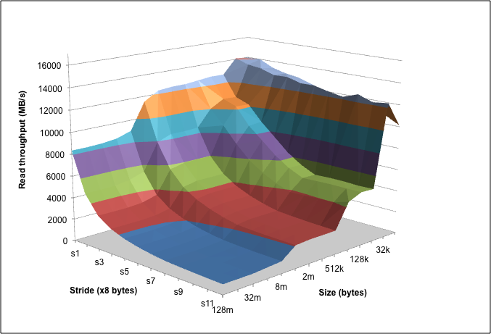
Introducing Computer Systems from a
Programmer’s Perspective
Randal E. Bryant, David R. O’Hallaron
Computer Science, Electrical & Computer Engineering
Carnegie Mellon University

Slide 2
Outline
Introduction to Computer Systems
  Course taught at CMU since Fall, 1998
  Some ideas on labs, motivations, …
Computer Systems: A Programmer’s Perspective
  Our textbook, now in its third edition
  Ways to use the book in different courses

Slide 3
Background
1995-1997: REB/DROH teaching computer architecture course at CMU.
  Good material, dedicated teachers, but students hate it
  Don’t see how it will affect their lives as programmers

Slide 4
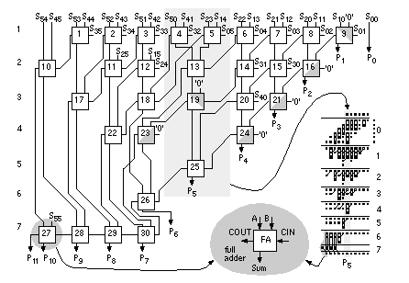
Computer Arithmetic
Builder’s Perspective
32-bit
Multiplier
  How to design high performance arithmetic circuits

Slide 5
Computer Arithmetic
Programmer’s Perspective
void show_squares()
{
int x;
for (x = 5; x <= 5000000; x*=10)
printf("x = %d x^2 = %d\n", x, x*x);
}
x = 5 x² = 25
x = 50 x² = 2500
x = 500 x² = 250000
x = 5000 x² = 25000000
x = 50000 x² = -1794967296
x = 500000 x² = 891896832
x = 5000000 x² = -1004630016
  Numbers are represented using a finite word size
  Operations can overflow when values too large
    But behavior still has clear, mathematical properties

Slide 6
Memory System
Builder’s Perspective
Builder’s Perspective
  Must make many difficult design decisions
  Complex tradeoffs and interactions between components
Direct mapped or set indexed?
Synchronous
or
asynchronous?
Write through or write back?
Main
memory
Regs
L1 d-cache
L2
unified
cache
Disk
CPU
L1 i-cache
How many lines?
Virtual or physical indexing?

Slide 7
Memory System
Programmer’s Perspective
void copyij(int src[2048][2048],
int dst[2048][2048])
{
int i,j;
for (i = 0; i < 2048; i++)
for (j = 0; j < 2048; j++)
dst[i][j] = src[i][j];
}
void copyji(int src[2048][2048],
int dst[2048][2048])
{
int i,j;
for (j = 0; j < 2048; j++)
for (i = 0; i < 2048; i++)
dst[i][j] = src[i][j];
}
4.3 ms
81.8 ms
(Measured on 2 GHz
Intel Core i7 Haswell)
19 times slower!
  Hierarchical memory organization
  Performance depends on access patterns
    Including how step through multi-dimensional array

Slide 8
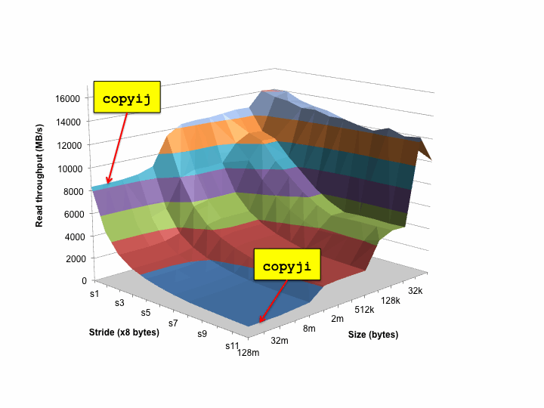
The Memory Mountain

Slide 9
Background (Cont.)
1997: OS instructors complain about lack of preparation
  Students don’t know machine-level programming well enough
    What does it mean to store the processor state on the run-time stack?
  Our architecture course was not part of prerequisite stream

Slide 10
Birth of ICS
1997: REB/DROH pursue new idea:
  Introduce them to computer systems from a programmer's perspective rather than a system designer's perspective.
  Topic Filter: What parts of a computer system affect the correctness, performance, and utility of my C programs?
1998: Replace architecture course with new course:
  15-213: Introduction to Computer Systems
Curriculum Changes
  Sophomore level course
  Eliminated digital design & architecture as required courses for CS majors

Slide 11
15-213: Intro to Computer Systems
Goals
  Teach students to be sophisticated application programmers
    Direct benefit to students who never take another systems course
  Prepare students for upper-level systems courses
Taught every semester to 400+ students
  All CS undergrads (core course)
  All ECE undergrads (core course)
  Many masters students
    To prepare them for upper-level systems courses
  Variety of others from math, physics, statistics, …
Preparation
  Optional: Introduction to CS in Python or Ruby
  Imperative programming in C subset

Slide 12
ICS Feedback
Students
Faculty
  Prerequisite for most upper level CS systems courses
  Also required for ECE embedded systems, architecture, and network courses

Slide 13
Lecture Coverage
Data representations [3]
  It’s all just bits.
  int’s are not integers and float’s are not reals.
x86-64 machine language [5]
  Analyzing and understanding compiler-generated machine code.
Program optimization [2]
  Understanding compilers and modern processors.
Memory Hierarchy [3]
  Caches matter!
Linking [1]
  With DLL’s, linking is cool again!

Slide 14
Lecture Coverage (cont)
Exceptional Control Flow [2]
  The system includes an operating system that you must interact with.
Virtual memory [4]
  How it works, how to use it, and how to manage it.
Application level concurrency [3]
  Processes and threads
  Races, synchronization
I/O and network programming [4]
  Programs often need to talk to other programs.
Total: 27 lectures, 14 week semester

Slide 15
Labs
Key teaching insight:
  Cool Labs ⇒ Great Course
A set of 1 and 2 week labs define the course.
Guiding principles:
  Be hands on, practical, and fun.
  Be interactive, with continuous feedback from automatic graders
  Find ways to challenge the best while providing worthwhile experience for the rest
  Use healthy competition to maintain high energy.

Slide 16
Lab Exercises
Data Lab (2 weeks)
  Manipulating bits.
Bomb Lab (2 weeks)
  Defusing a binary bomb.
Attack Lab (1 week)
  Buffer overflow and return-oriented programming exploits
Cache Lab (2 weeks)
  Write basic cache simulator and then optimize application
Shell Lab (1 week)
  Writing your own shell with job control.
Malloc Lab (2-3 weeks)
  Writing your own malloc package.
Proxy Lab (2 weeks)
  Writing your own concurrent Web proxy.

Slide 17
Data Lab
Goal: Solve some “bit puzzles” in C using a limited set of logical and arithmetic operators.
  Examples: absval(x), greaterthan(x,y), log2(x)
Lessons:
  Information is just bits in context.
  C int’s are not the same as integers.
  C float’s are not the same as reals.
Infrastructure
  Configurable source-to-source C compiler that checks for compliance.
  Instructor can automatically select from 45 puzzles.
  Automatic testing using formal verification tools

Slide 18
Let’s Solve a Bit Puzzle!
/*
* abs - absolute value of x (except returns TMin for TMin)
* Example: abs(-1) = 1.
* Legal ops: ! ~ & ^ | + << >>
* Max ops: 10
* Rating: 4
*/
int abs(int x) {
int mask = x>>31;
return ____________________________;
}
11…1₂, = –1, x < 0
00…0₂, = 0, x ≥ 0
(x^mask)
+ 1+~mask
–x – 1, x < 0
x, x ≥ 0
+
1, x < 0
0, x ≥ 0
=
–x, x < 0
x, x ≥ 0

Slide 19
Bomb Lab
  Idea due to Chris Colohan, TA during inaugural offering
Bomb: C program with six phases.
Each phase expects student to type a specific string.
  Wrong string: bomb explodes by printing BOOM! (− ½ pt)
  Correct string: phase defused (+10 pts)
  In either case, bomb sends message to grading server
  Server posts current scores anonymously and in real time on Web page
Goal: Defuse the bomb by defusing all six phases.
  For fun, we include an unadvertised seventh secret phase
The challenge:
  Each student get only binary executable of a unique bomb
  To defuse their bomb, students must disassemble and reverse engineer this binary

Slide 20
Properties of Bomb Phases
Phases test understanding of different C constructs and how they are compiled to machine code
  Phase 1: string comparison
  Phase 2: loop
  Phase 3: switch statement/jump table
  Phase 4: recursive call
  Phase 5: pointers
  Phase 6: linked list/pointers/structs
  Secret phase: binary search (biggest challenge is figuring out how to reach phase)
Phases start out easy and get progressively harder

Slide 21
Let’s defuse a bomb phase!
0000000000400a6c <phase_2>:
... # function prologue not shown
400a72: mov %rsp,%rsi
400a75: callq 4010ba <read_six_numbers>
400a7a: cmpl $0x1,(%rsp)
400a7e: je 400a85 <phase_2+0x19>
400a80: callq 400f6d <explode_bomb>
400a85: lea 0x4(%rsp),%rbx
400a8a: lea 0x18(%rsp),%rbp
400a8f: mov -0x4(%rbx),%eax
400a92: add %eax,%eax
400a94: cmp %eax,(%rbx)
400a96: je 400a9d <phase_2+0x31>
400a98: callq 400f6d <explode_bomb>
400a9d: add $0x4,%rbx
400aa1: cmp %rbp,%rbx
400aa4: jne 400a8f <phase_2+0x23>
... # function epilogue not shown
400aac: c3 retq
# rd 6 ints into buffer
# p = &buf[1]
# pend = &buf[6]
# LOOP: v = buf[0]
# v = 2*v
# if v == *p
# then goto OK:
# else explode!
# OK: p++
# if p != pend
# then goto LOOP:
# YIPPEE!

Slide 22
The Beauty of the Bomb
For the Student
  Get a deep understanding of machine code in the context of a fun game
  Learn about machine code in the context they will encounter in their professional lives
    Working with compiler-generated code
  Learn concepts and tools of debugging
    Forward vs backward debugging
    Students must learn to use a debugger to defuse a bomb
For the Instructor
  Self-grading
  Scales to different ability levels
  Easy to generate variants and to port to other machines

Slide 23
Attack Lab
int getbuf()
{
char buf[4];
/* Read line of text and store in buf */
gets(buf);
return 1;
}
Task
  Each student assigned “cookie”
    Randomly generated 8-digit hex string
  Generate string that will cause getbuf to call function touch2 with cookie as argument
    Instead of 1

Slide 24
Buffer Code
Stack when gets called
Stack Frame
for test
void test(){
int v = getbuf();
...
}
Return
address
Return Address
(8 bytes)
void getbuf() {
char buf[4];
gets(buf);
return 1;
}
20 bytes unused
Increasing
addresses
[3]
[2]
[1]
[0]
buf
%rsp
  Calling function gets(p) reads characters up to ‘\n’
  Stores string + terminating null as bytes starting at p
  Assumes enough bytes allocated to hold entire string

Slide 25
Exploit String Example
Stack after call to gets()
test
stack frame
void getbuf() {
char buf[12];
gets(buf);
return 1;
}
B
pad
data written
by gets()
  Sets 0x59b997fa as function argument
  Invokes function touch2
getbuf
stack frame
exploit
code
B
/* Byte code for shell code
movq $0x59b997fa,%rdi; ret */
48 c7 c7 fa 97 b9 59 c3
/* Pad with 16 bytes */
00 00 00 00 00 00 00 00
00 00 00 00 00 00 00 00
/* Address of shellcode */
78 dc 61 55 00 00 00 00
/* Address of touch2 */
0c 18 40 00 00 00 00 00

Slide 26
Why Do We Teach This Stuff?
Important Systems Concepts
  Stack discipline and stack organization
  Instructions are byte sequences
  Making use of tools
    Debuggers, assemblers, disassemblers
Computer Security
  What makes code vulnerable to buffer overflows
  Common vulnerability in systems
Impact
  CMU student teams consistently win international Capture the Flag Competitions

Slide 27
CMU Courses that Build on ICS
CS
Robotics
ECE
Parallel
Prog.
Compilers
Dist.
Systems
Cog.
Robotics
Embedded
Control
Secure
Coding
Networks
Storage
Systems
Comp.
Photo.
Real-Time
Systems
Software
Engin.
Operating
Systems
Databases
Computer
Graphics
Embedded
Systems
Computer
Arch.
ICS

Slide 28
Fostering “Friendly Competition”
Desire
  Challenge the best without frustrating everyone else
Method
  Web-based submission of solutions
  Server checks for correctness and computes performance score
    How many stages passed, program throughput, …
  Keep updated results on web page
    Students choose own nom de guerre
Relationship to Grading
  Students get full credit once they reach set threshold
  Push beyond this just for own glory/excitement

Slide 29
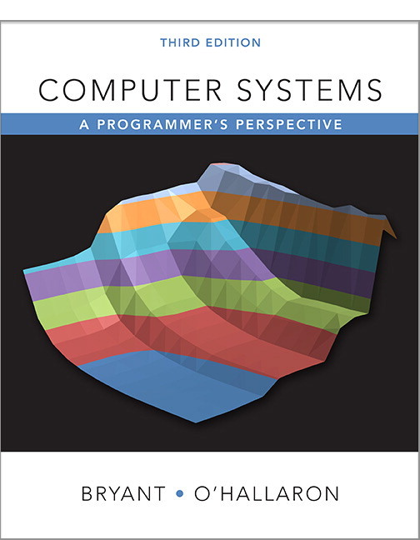
Shameless Promotion
  http://csapp.cs.cmu.edu
  Third edition published 2015
  In use at 289 institutions worldwide

Slide 30
Coverage
Material Used by ICS at CMU
  Pulls together material previously covered by multiple textbooks, system programming references, and man pages
Greater Depth on Some Topics
  Dynamic linking
  I/O multiplexing
Additional Topic
  Computer Architecture
  Added to cover all topics in “Computer Organization” course

Slide 31
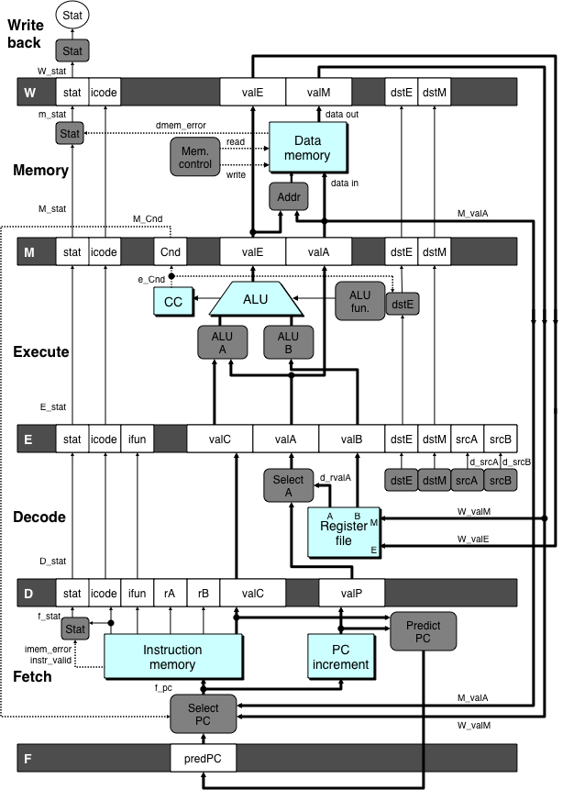
Architecture
Material
  Y86-64 instruction set
    Simplified/reduced x86-64
  Implementations
    Sequential
    5-stage pipeline
Presentation
  Simple hardware description language to describe control logic
  Automatic translation to simulator and to Verilog
Labs
  Modify / extend processor design
    New instructions
    Change branch prediction policy
  Optimize application + processor

Slide 32
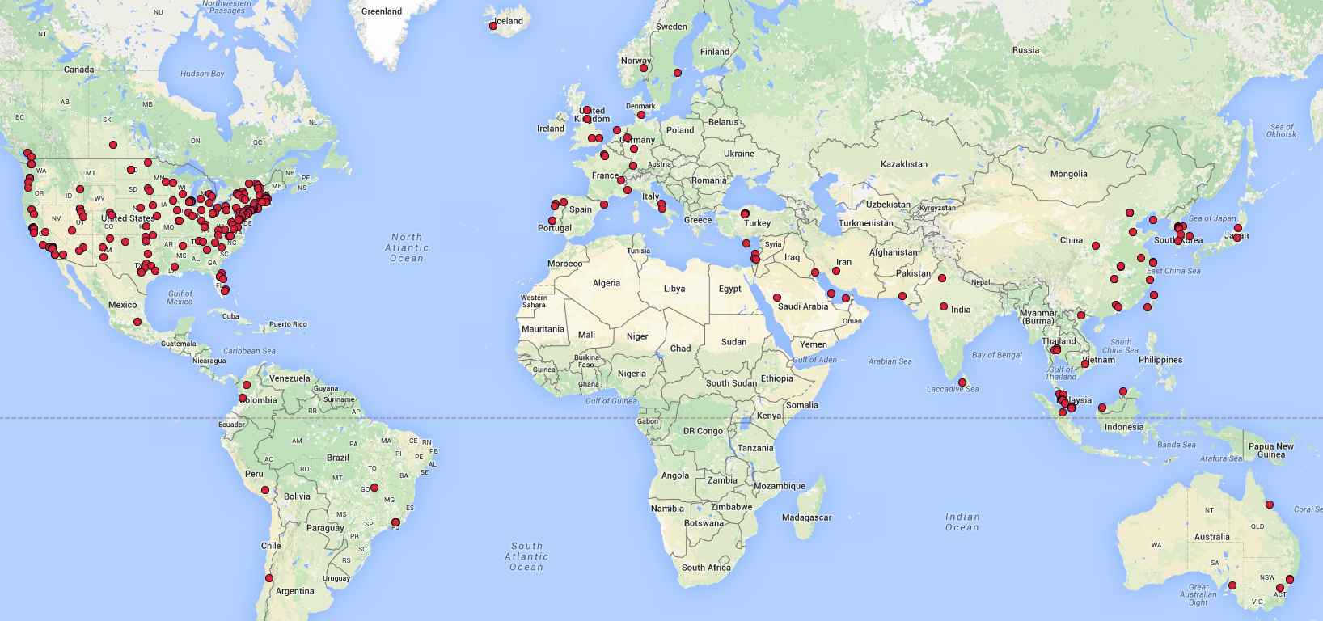
Worldwide Adoptions
289 total

Slide 33
Conclusions
ICS Has Proved Its Success
  Many thousands of students at CMU over 18 years
  Positive feedback from alumni
  Positive feedback from systems course instructors
CS:APP is International Success
  Supports variety of course styles
  Many purchases for self study

