Slide 1
Overcoming Environmental and Metal Interference Using Multi-Frequency RFID Part 2
Team: Jake Boudreaux, Liz Raymond, Sam Irving, Paige Harris
Advisors: Daniel Baxter, John Scalzo

Slide 2
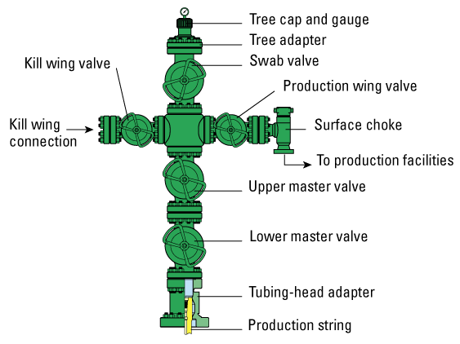
Project Overview
Funded by Cameron
Continuation of the 2010 Capstone
series project
Used for Inventory Management of
Christmas Tree Oil Wells in Harsh
Conditions
Spirit of Innovation

Slide 3
Two Project Objectives
Solve the power consumption issue of last year’s project
Wake-up Circuit
Providing a unique but efficient way accessing and displaying oil well valve information utilizing an active RFID network
Augmented Reality System

Slide 4
Main Requirements
Design Goals
Range | 20ft
Life Span | 3-5 Years
Reliability | 100%
Dimensions | Ideal: 2”x2”x1” Max: 8”x8”x1”
Regulations | FCC Compliant
/
Notes:
Many of these are ideal goals, such as the lifespan and the dimension

Slide 5
Wake-Up Circuit
Cameron 2.0

Slide 6
Wake-Up Circuit
Antenna
Filter
Amplifier
MCU
Load Switch
Wake-up Circuit Diagram
Notes:
Reasons for Wake-up Circuit, Basic Design consists of:

Slide 7
Antenna: Antenova Titanis 2.4GHz
Distance Test
Polarization
Test

Slide 8
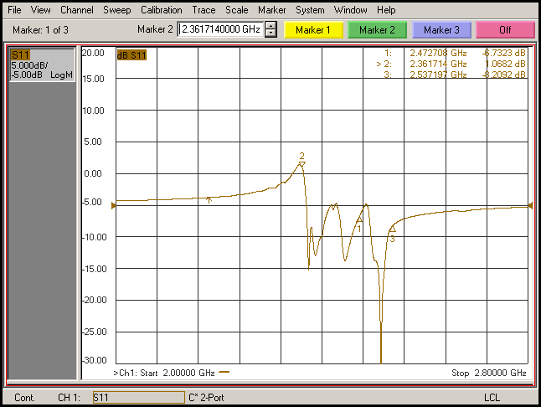
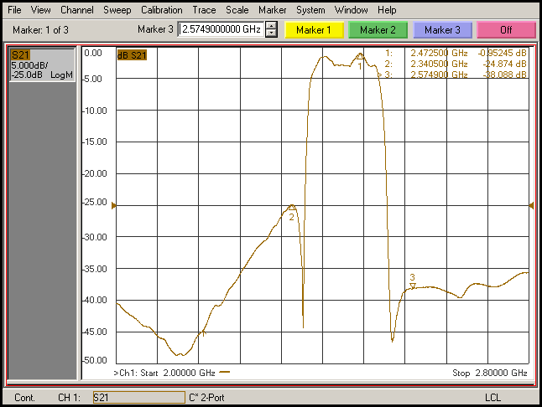
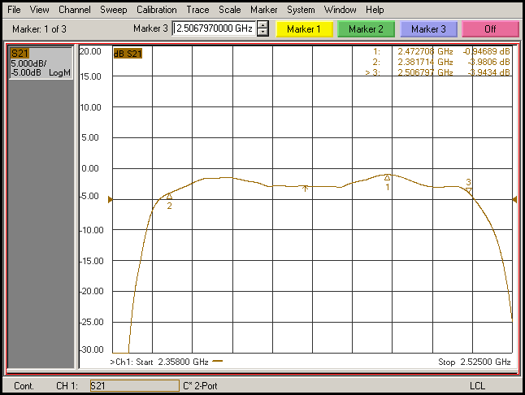
Filter
These tests were run with the Sawtek 855916 SAW Filter
Antenna + Filter
S11 Characteristic

Slide 9
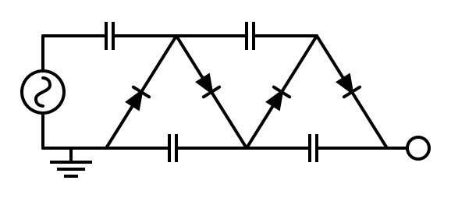
Amplifier
Half-Wave
Cockcroft-Walton
Full-Wave
Cockcroft-Walton

Slide 10
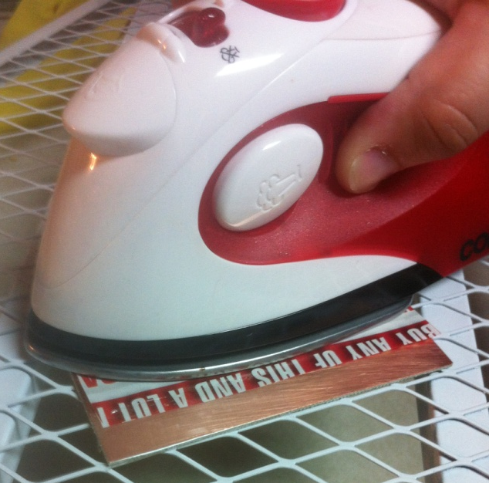
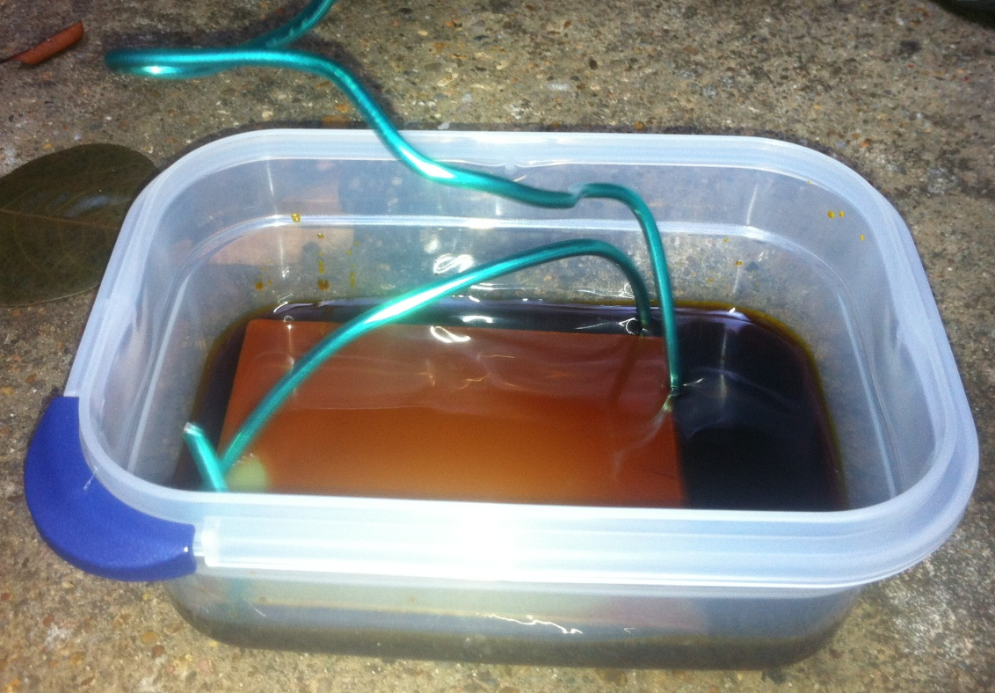
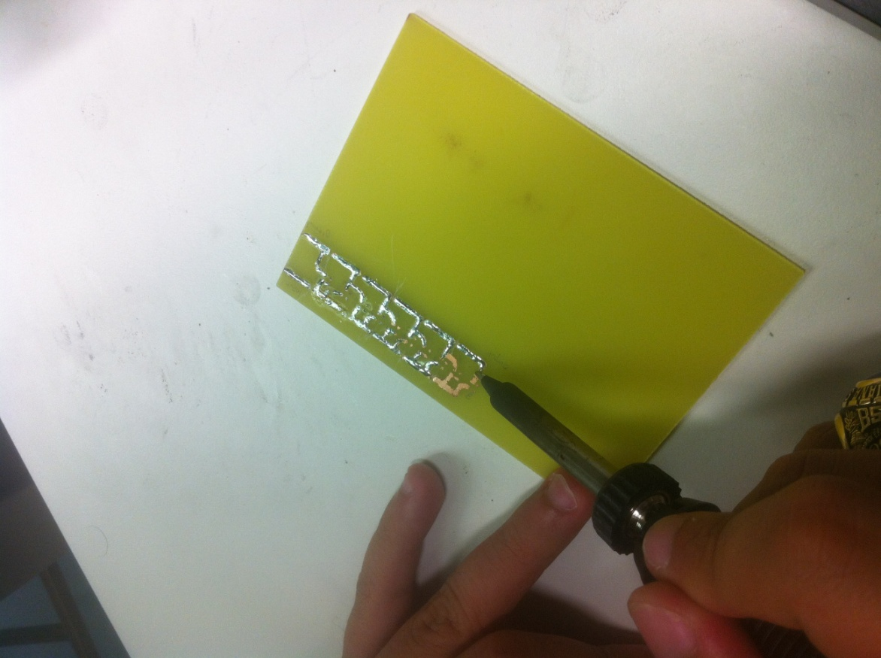
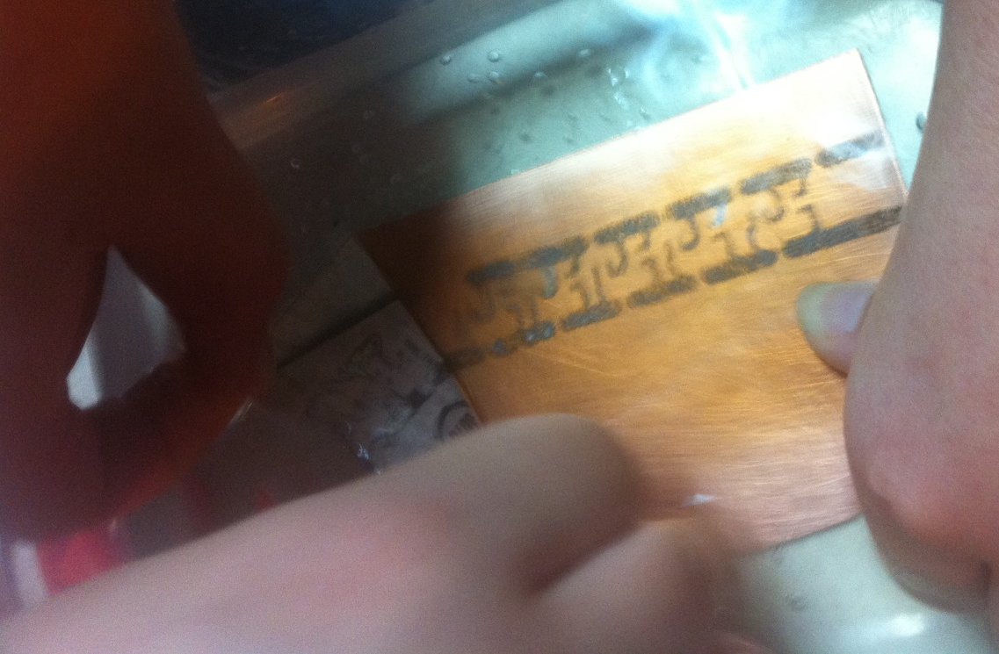
Home Etching PCBs

Slide 11
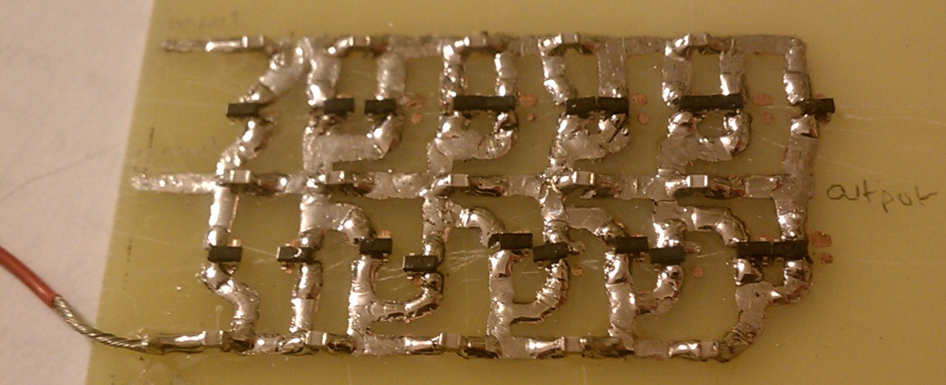
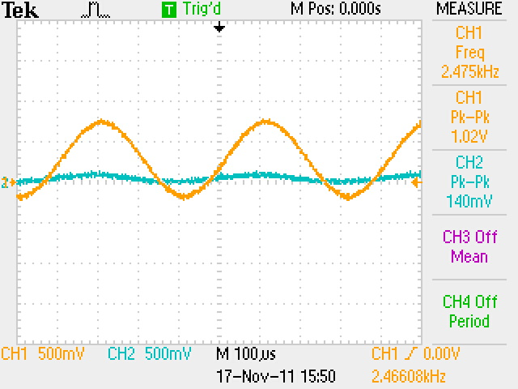
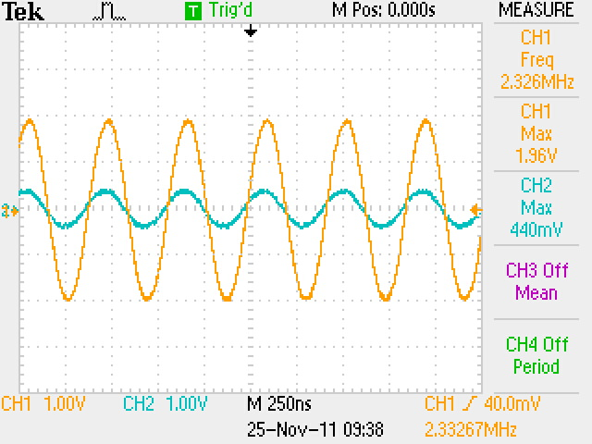
Physical PCB Evaluation
5 Stage Half-Wave
5 Stage Full-Wave

Slide 12
Amplifier Simulation
2.4MHz works in simulation, should have worked in lab. Half-wave, two stages
Diodes not the same, but also RF class
150kHz
2.4MHz

Slide 13
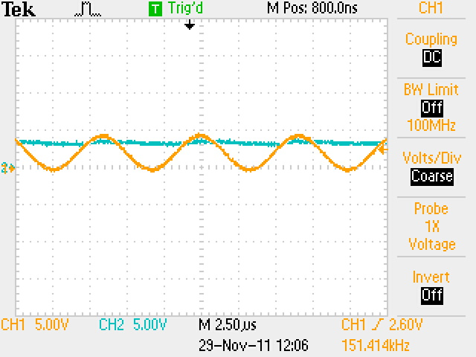
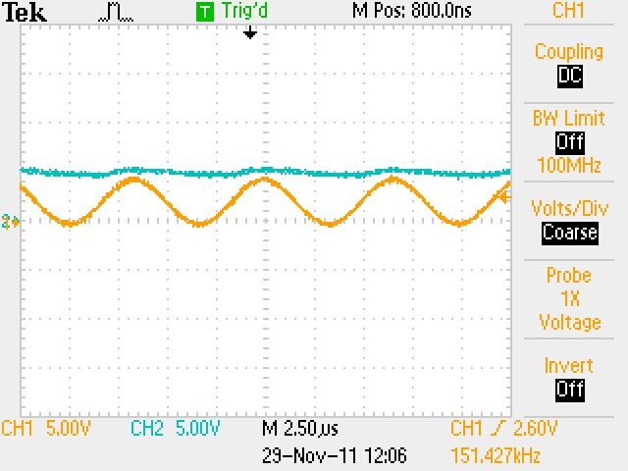
Amplifier Breadboard
Built a half-wave amplifier. Tested at 1 and 2 stages, at 150kHz
Stage 1
Stage 2

Slide 14
Amplifier Transistor
Don’t know what kind we need
Don’t know actual output of amplifier
The lower the threshold, the more expensive.
If output is high enough, might not even need one

Slide 15
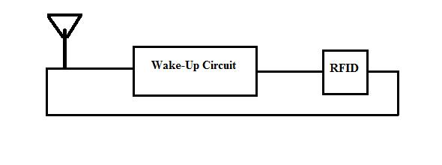
Signal Switch
Issue
Solution

Slide 16
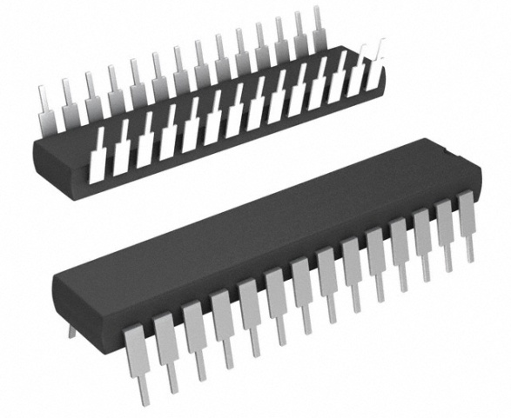
Need for Microcontroller
Serves three purposes:
Wake-up RFID tag
Prevents endless loop scenario
Prevents signal loss

Slide 17
MCU Test

Slide 18
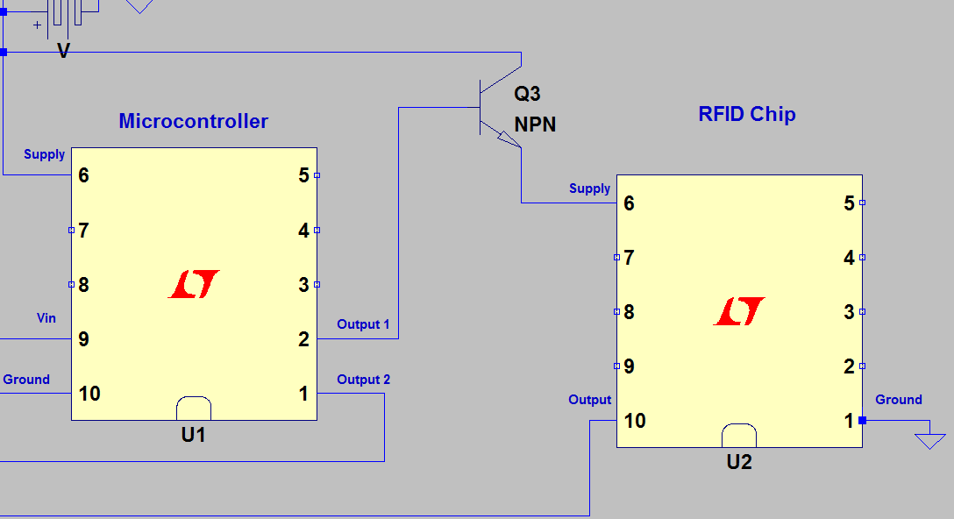
Power Switch
Power to the RFID

Slide 19
Component Alternatives
Antenna
Filter
Amplifier
MCU
RF Tag

Slide 20
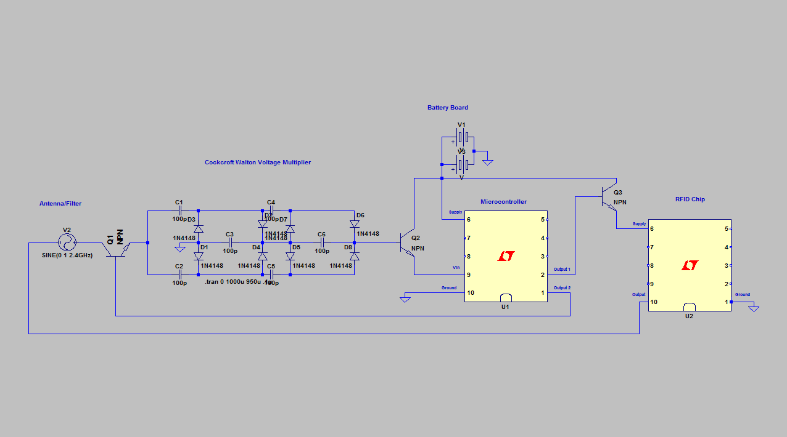
Final Schematic

Slide 21
Power Calculations
Tag scanned once per day, 2AA batteries:
Non-sleep mode
Sleep mode
Lithium Thionyl Chloride (AA)
Capacity | 2400mAh
Voltage | 3.6V
Current | 100mA max
Temperature | -55° C - 85° C
Self Discharge | <1% Per Year

Slide 22
Lessons Learned
Proper Documentation
Learned from 2010 Capstone Group
Underestimation of Intensity
Just because the circuit looks simple, does not mean it will be simple to build
Time Management
Account for delivery delays and incorrect commercial inventory lists

Slide 23
Performance Goals
The main goal was to have a working prototype
To accomplish this we broke it into four goals:
Antenna
Filter
Amplifier
MCU

Slide 24
Cost Analysis
5 Stage Full-Wave Amplifier Tag Cost Estimate
Component | Unit Price $ | Total Price $
Diodes x20 | 0.246 | 4.92
Capacitors x15 | 0.73 | 10.95
RFID Chip x1 | 4.16 | 4.16
Antenna x1 | 12.00 | 12.00
Transistors x3 | 0.033 | 0.099
Batteries x2 | 2.85 | 5.70
Micro Controller x1 | 5.00 | 5.00
Total Cost: |  | 42.83

Slide 25
Suggestions
Suggestions for Future Development
Refine and test amplifier
Test signal loss through signal switch
MCU Sleep Mode
Working case
Portable Reader

Slide 26
Augmented Reality App
Cameron 2.0

Slide 27
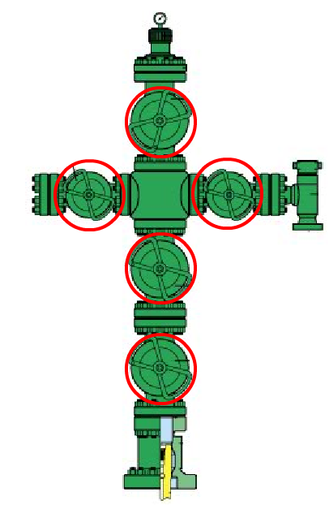
Project Objectives
To create an efficient and intuitive way of identifying oil well tree valves from ground level using Augmented Reality technology
To devise a method of dynamically determining the 3D location of the valves for AR execution

Slide 28
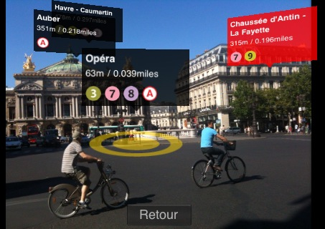
What is Augmented Reality?
The process of
augmenting the
elements of the
real-world on a live,
direct or indirect, feed
Applies computer-generated imagery to the live stream to enhance the user’s perception of their environment

Slide 29
Requirements for AR
Database
Smart device
Internet Capability
Camera
Gyroscope
Accelerometer
Compass
Built-in GPS
3D location of each valve on the tree

Slide 30
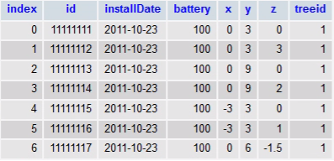
Database Development
MySQL database hosted on a server already owned by the group
Already confirmed to work with our development platform
Access database through web-service layer: phpAdmin
Unity reads database by using Javascript functions to execute PHP scripts

Slide 31
Application Development

Slide 32
Development Platform: Unity3D
What is Unity3D?
Integrated authoring tool for creating 3D video games or real-time 3D animations
Pros:
Supports multiple platforms
Notably iPhone and Android applications
Built-in 3D engine
Compiles directly to smart phone
Cons:
Does not natively support sensors
Expensive

Slide 33
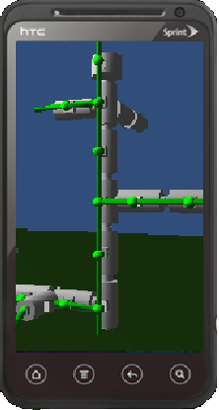
Application Front End
Unity3D
Demos
Android App
Camera Background
Menu System

Slide 34
Front End – Camera Background
Unity plugin
2D Camera Feed Conversion
Modified Augmented Reality
Enabled Camera = Lower Battery Life
Additional Feature?
Enable/Disable Camera
Virtual Valve Tree Substitution

Slide 35
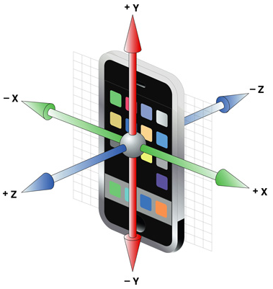
Application Back End
Accelerometer
Unity Sensor Plug-ins
Compass
Gyroscope
Gyroscope Correction
Inertial Navigation System
Tree Growing System

Slide 36
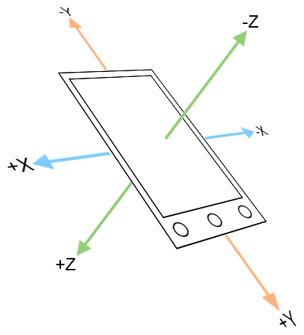
Back End – Accelerometer
Used to find the pitch and roll at which the phone is being held
Phone orientation is found using the force of gravity
Additional sensors needed without a perfect magnitude of $9.8 m/s^{2}$
Unstable

Slide 37
Back End – Gyroscope
Used to estimate the phones orientation when the accelerometer senses that the phone is in motion
Less impacted by shaking.
Improves how steady the Augmented Reality labels are
All scripts will run on phones with or without a built in gyroscope.

Slide 38
Back End – Inertial Navigation
The phone’s 3D displacement can be found knowing an initial starting location and the phones acceleration
Used to track the phone’s location between database updates
Accuracy decreases over time
Needed if the Augmented Reality user is in motion.

Slide 39
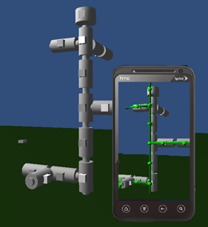
Back End – Tree Growing System
Database generates a tree “skeleton”
Removes labeling ambiguity
Minimizes 3D and phone orientation inaccuracy
“Base” node
Active RFID tags unnecessary for valve location after installation

Slide 40
3D Location Determination

Slide 41
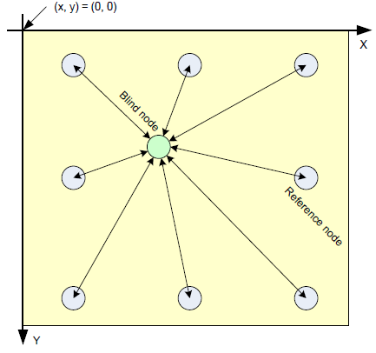
Hardware Limitations
CC2431 Location Engine
Accuracy of the system increases with the number of known points around the unknown point.
At least 6 reference nodes needed for an estimated 2D location that may only be
accurate within 3 – 5 meters
Nodes must be positioned
perfectly so that the antenna
signals are projecting towards
unknown node

Slide 42
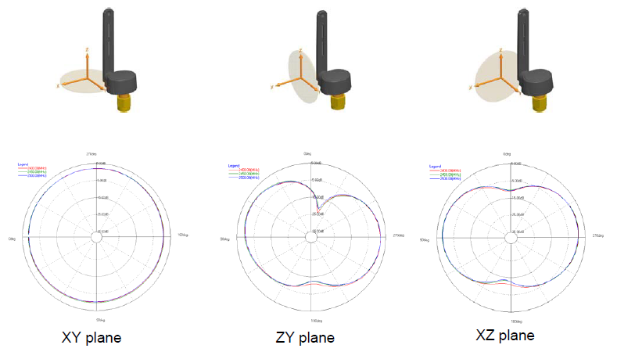
Hardware Limitations Cont’d
Antenova Titanis 2.4GHz Swivel Antenna
No spherical or symmetrical signal
RSSI values used to estimate distances between nodes
Up to 95% of the signal can be lost in certain antenna orientations

Slide 43
3D Location Determination
Utilizing a system similar to the trilateration system demonstrated by the Mega Hurtz group

Slide 44
Demo

Slide 45
Acknowledgements
Overall Project
Daniel Baxter, Cameron
John Scalzo, LSU
Augmented Reality
Dr. Jerry Trahan, LSU
Wake-Up Circuit
Jacob Luby
Karl Oelschlaeger
Heather McKay
Jordan LeFler

Slide 46
Questions ?

