Slide 1
3D View Simulation Based on Face Tracking
Final Presentation for EE7700 DVP
Shenghua Wan and Kang zhang
May, 2012

Slide 2
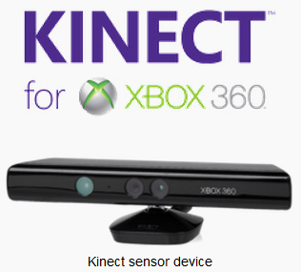
Motivation
Multi-touch User Interface
Physical Motion
Virtual Environment
Motion Sensing Game Consoles
Wii
Kinect
Infrared projector
and camera
Infrared sensor bar
Infrared LED

Slide 3
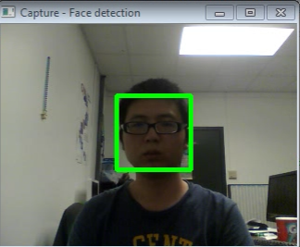
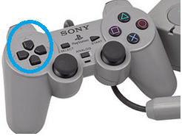
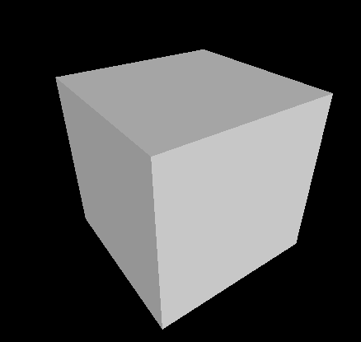
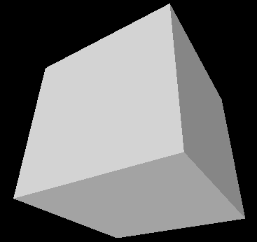
Objective
Face Motion
Tracking
Translations
Zoom
Virtual 3D Scene Explore
3D scene
e.g. a Cube with 8
points with different depth
values.
View Simulation

Slide 4
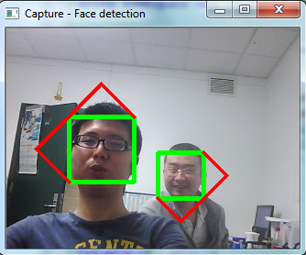
Methodology-Face Tracking 1
Haar Cascade Classifier (Viola & Jones 2001)
Haar-like features
Integral Image
AdaBoost (Freund & Schapire 1995)
Cascading
Implementation
OpenCV
Trained Classifier
Some Untuned Parameters

Slide 5
Methodology-Face Tracking 2
CAMShift
( Continuously Adaptive Mean-Shift )
Assumption
Image histogram of foreground object is time-invariant.
Back Projection
Mean Shift Algorithm
Locate new search window and goto 2
Implementation
OpenCV

Slide 6
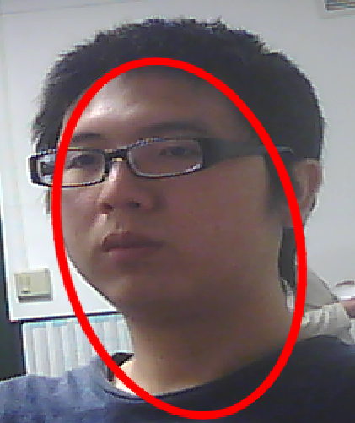
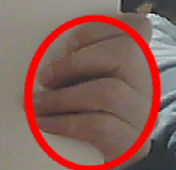
Methodology-Face Tracking 2(cont)
Some comments on CAMShift
Sensitive and fast
Not Robust
tend to be interfered by objects with similar color distribution.
face
arm
fingers
even notebook!

Slide 7
Experimental Results
Human face moves in real-world
Viewpoint moves in the simulated 3D scene as if we are looking at the real-world objects.

Slide 8
Thank you!

