Slide 1
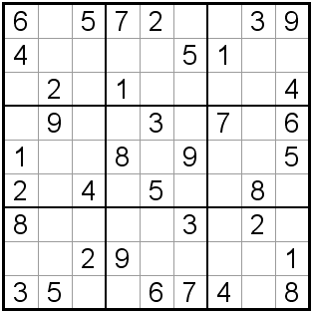
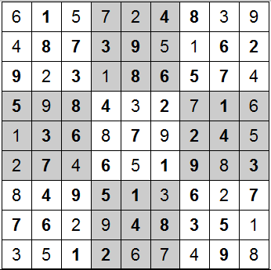
Sudoku Solver
By: Adam Hebert

Slide 2
Discussed Topics
Why Sudoku?
Attempts at an App
MATLAB Implementation
- Use of webcam
- Algorithm
Problems with method
Demonstration
Questions

Slide 3
Why Sudoku?
Not Skilled
Fun project
Practical if on Android
Original Idea

Slide 4
Attempts at an App
ADDI
- Can type in MATLAB code
- Upload .m files to phone
- Open .m files using program
- Only runs basic commands
MLConnect
- Creates server on PC using
MATLAB
- Allows you to connect to server
on android device
- Must be on local network
- Not Practical

Slide 5
MATLAB Implementation
Failed to create Android App
- Unable to convert MATLAB
into useable C/Java code
- Lack of time
- Did use MATLAB complier
- Had issues with resulting
code

Slide 6
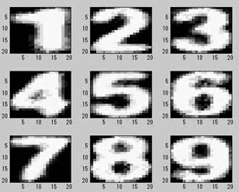
Use of webcam
Takes input frames from cam
- videoinput('winvideo',1,'YUY2_640x480');
Makes input video black and white
Reduces noise
Checks each row and column for a number that matches the template
Creates a red circle around objects that match template
Takes those inputs and stores into 2d matrix

Slide 7
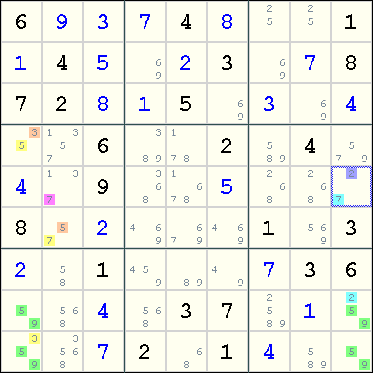
Algorithm
Checks the row/column/block to see if there is only 1 possible number
If so, it uses that number, then updates the other blocks
If there is greater than 1 possible number, it checks each to see which is correct
Essentially makes an educated guess as to which is correct
Checks results
Uses a 3d matrix
Outputs the result in a Sudoku template

Slide 8
Problems with method
Tried newspaper cutout
Has trouble detecting puzzle on dark backgrounds
Border needs to be thick
Template restraints
Edges needs to be straight

Slide 9
Demonstration!

Slide 10
Questions?

