Slide 1
Face tracking
EE 7700
Name: Jing Chen Shaoming Chen

Slide 2
Outline
Introduction
Viola-Jones face detection
Face tracking based on Camshift
Conclusion & Discussion
Result demonstration

Slide 3
introduction
Face tracking
Face detection
object tracking
Our method
Viola-Jones
Camshift

Slide 4
Face detection
Viola-Jones Face Detection Algorithm
Feature Extraction
Boosting- the combination of weak classifiers
Multi-scale detection algorithm

Slide 5
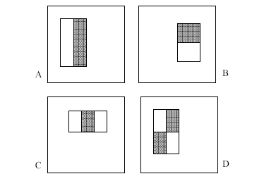
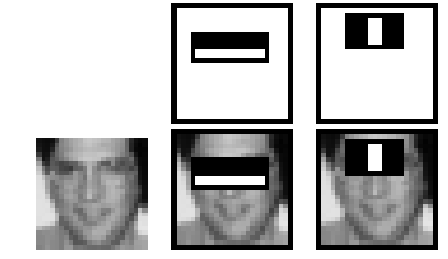
Face detection
Feature Extraction
Four basic types
The white areas are subtracted from the black ones
A special representation: integral image---computes a value at each pixel (x,y) that is the sum of the pixel values above and to the left of (x,y), inclusively
and to the left of (x,y),
inclusive.
pixel (x,y) that is the sum
of the pixel values above
and to the left of (x,y),
inclusive.

Slide 6
Face detection
Fast computation of pixel sums
A
B
the value of the integral image at location 1
is the sum of the pixels in rectangle A
the value at location 2 is A+B
the value at location 3 is A+C
the value at location 4 is A+B+C+D
the sum within D can be obtained by
4+1-2-3
1
2
C
D
3
4

Slide 7
Face detection
Boosting
Learn a single simple classifier and check where it makes errors
Reweight the data, make the inputs where it made errors get higher weight
Learn a 2nd simple classifier on the weighted data
Combine the 1st and 2nd classifier and weight the data according to where they make errors
Keep learning until we learn T simple classifiers
Final classifier is the combination of all T classifiers

Slide 8
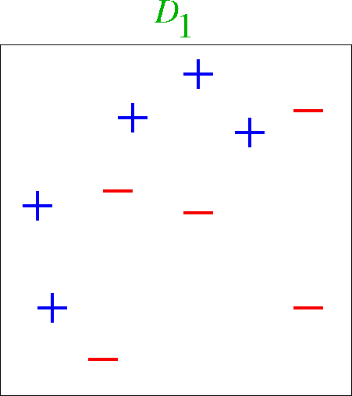
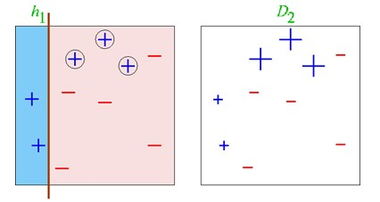
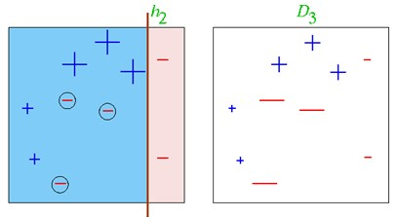
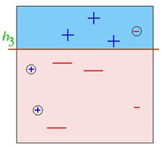
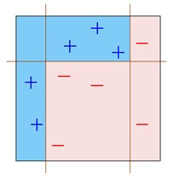
Face detection
Boosting

Slide 9
Face detection
Multi-scale detection
Faces with different scales
Features should be calculate at different scales
Scale by factors of 1.2

Slide 10
Camshift
CAMSFHIT
Continuously Adaptive Mean Shift
skin probability based on the Hue of HSV color model
Pro
Simple & fast

Slide 11
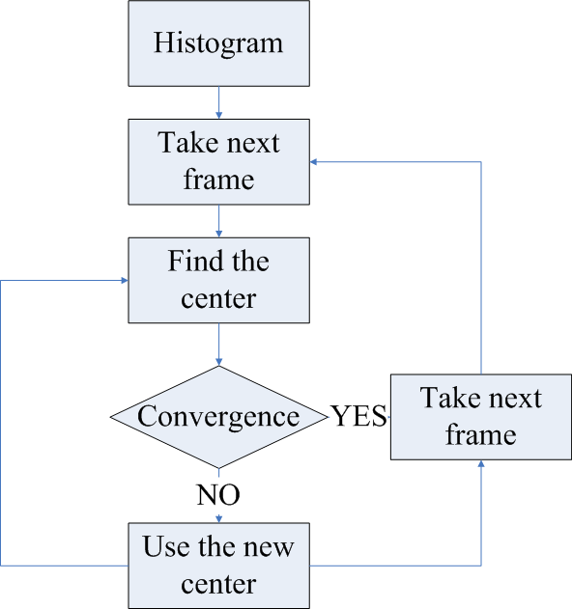
Camshift
Hue channel
Histogram

Slide 12
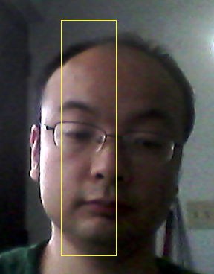
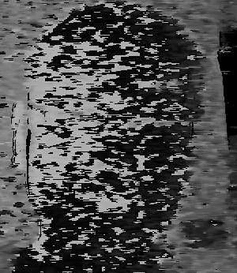
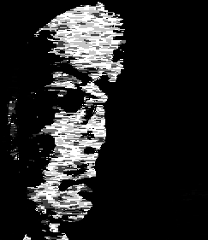
Camshift
H CHANNEL
Histogram

Slide 13
Camshift
http://fr.wikipedia.org/wiki/Camshift

Slide 14
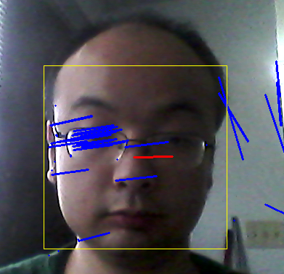
Optical flow tracking

Slide 15
Conclusion & Discussion
Limitation
Different positions of face
Skin color VS background
Low saturation
Lighting condition
Improvement
Training set
Pre-processing

Slide 16
Thank you!

