Slide 1
Computational and Quantitative
Imaging and Geometric Analysis Research at CCT/LSU
Xin Shane Li
Geometric and Visual Computing (GVC) Lab
School of Electrical Engineering & Computer Science (EECS) and Center for Computation & Technology (CCT)
Louisiana State University
Medical Physics Research Retreat
Feb. 28, 2013

Slide 2
Geometric Data Processing Research in GVC
Research Expertise:
Geometric/Image Data Modeling and Analysis
Applications in Graphics, Visualization, and other scientific fields
Developed Geometric/Image Processing Techniques
Data Matching and Mapping
Establish correspondence between geometric data
Computer parameterization on given shapes
Data Reconstruction and Restoration
Repair damaged or fragmented data
Dynamic Data Modeling
Build deformable models fitting sequential data for motion analysis and prediction

Slide 3
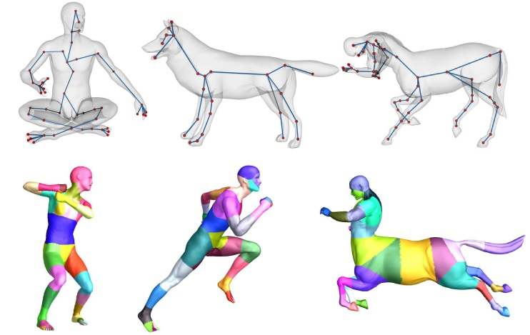
Geometric Data Processing Research in GVC
Research Expertise:
Geometric/Image Data Modeling and Analysis
Applications in Graphics, Visualization, and other scientific fields
Developed Geometric/Image Processing Techniques
Data Matching and Mapping
Establish correspondence between geometric data
Application: Difference comparison/Shape retrieval, Animate the physical deformation between geometries
[Video]
[Video]
[Li et al. “Globally Optimal Surface Mapping for Shapes of Arbitrary Topology,” IEEE Trans. on Visualization and Computer Graphics (TVCG), 14(4): 805-819, 2008.]
[Li et al. “Surface Mapping using Consistent Pants Decomposition,” IEEE Trans. on Visualization and Computer Graphics (TVCG), 15(4): 805-819, 2009 ]
[Yu and Li, “Computing 3D Shape Guarding and Star Decomposition,” Computer Graphics Forum (CGF), 30(7):2087-2096, 2011]

Slide 4
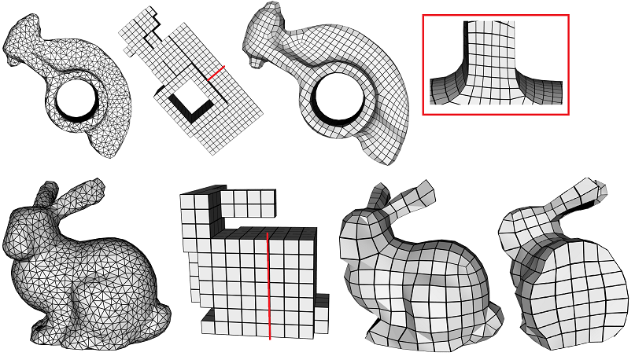
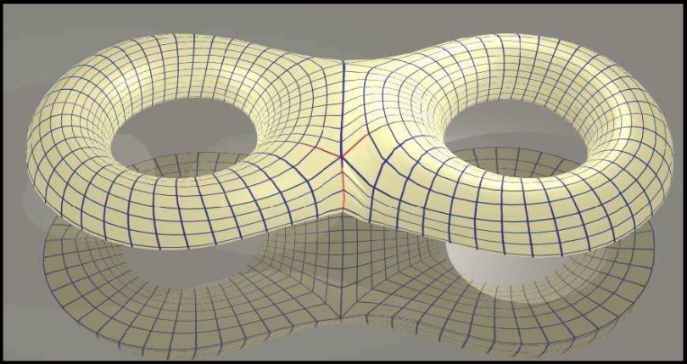
Geometric Data Processing Research in GVC
Research Expertise:
Geometric/Image Data Modeling and Analysis
Applications in Graphics, Visualization, and other scientific fields
Developed Geometric/Image Processing Techniques
Data Matching and Mapping
Establish correspondence between geometric data
Compute parameterization on given geometry
Application: High quality meshing for finite element analysis/simulation from raw data
[Wan et al. “A Topology-Preserving Optimization Algorithm for Polycube Mapping,” Computers & Graphics, 35(3):639-649, 2011]
[Wang et al. “Restricted Trivariate Polycube Splines for Volumetric Data Modeling,” IEEE Trans. on Visualization and Computer Graphics, 18(5):703-716, 2012.]
[Li et al. “Surface Mesh to Volumetric Spline Conversion with Generalized Poly-cubes,” IEEE Transactions on Visualization and Computer Graphics, in press, 2013.]

Slide 5
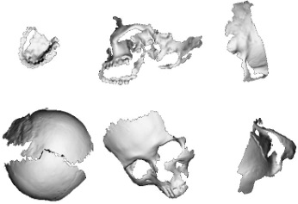
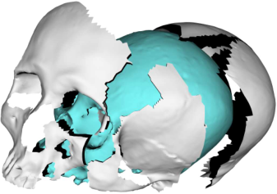
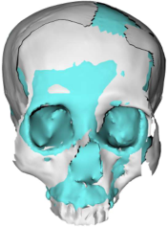
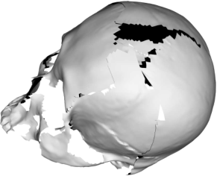
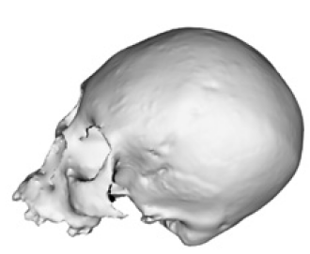
Geometric Data Processing Research in GVC
Research Expertise:
Geometric/Image Data Modeling and Analysis
Applications in Graphics, Visualization, and other scientific fields
Developed Geometric/Image Processing Techniques
Data Matching and Mapping
Establish correspondence between geometric data
Compute parameterization on given geometry
Data Reconstruction and Restoration
Repair incomplete/damaged data
Application: data restoration, pattern recognition in forensics, archaeology, …
Dynamic Data Modeling
[Li et al. “Symmetry and Template Guided Skull Completion,” Computers & Graphics, 35(4):885-893, 2011]
[Yin et al. “An Automatic Assembly and Completion Framework for Fragmented Skulls,” ICCV, pp. 2532-2539, 2011]
[Yu et al. “Fragmented Skull Modeling Using Heat Kernels,” Graphical Models, 74(4):140-151, 2012]

Slide 6
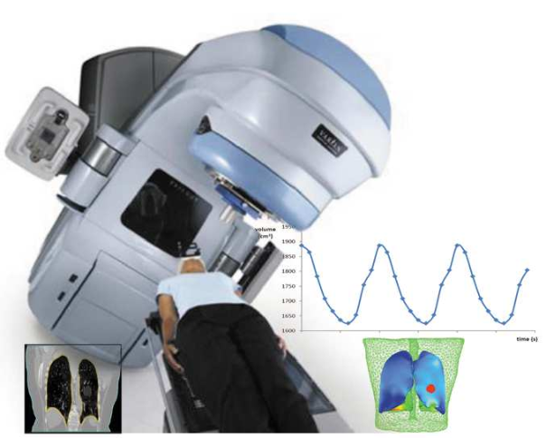
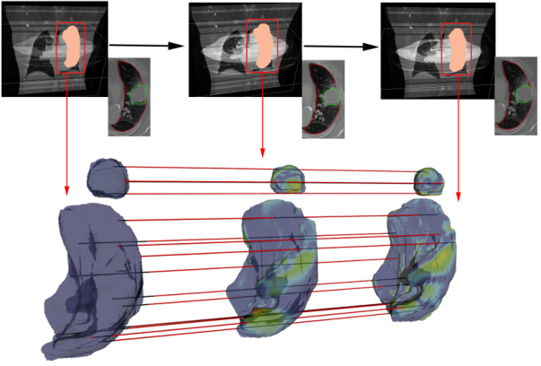
Respiratory Motion Modeling for Lung Tumor Tracking
Goal:
Using temporally scanned (3D+T) CT + (2D+T) MRI data
To construct a deformation model to mimic the motions of the lung tumor and surrounding tissues → to predict their location/motion/geometry
To guide the optimization of the radiation beam on its location, target direction, and MLC shape dynamically
[Iyengar, Li, Sawant et al. “Toward more precise radiotherapy treatment of lung tumors,” IEEE Computer 45(1):59-65, 2012.]
Collaborated with Amit Sawant from UT Southwestern Medical Center since 2011

Slide 7
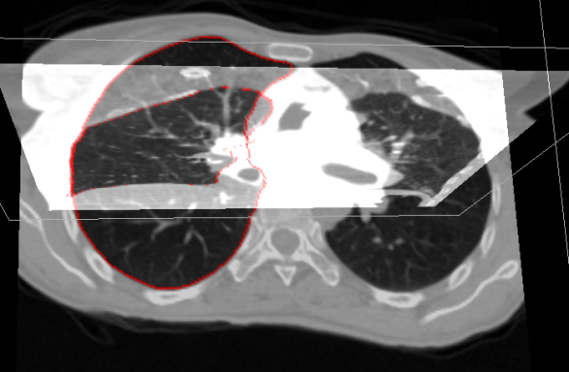
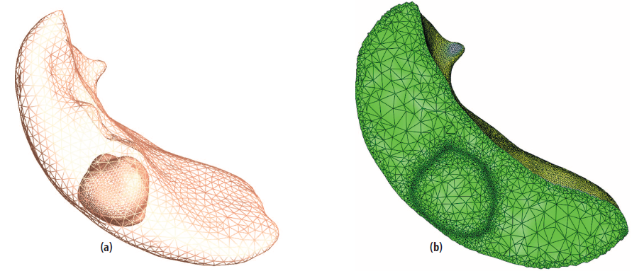
Respiratory Motion Modeling for Lung Tumor Tracking
Developed Medical Image Computing Techniques
Image Analysis and Segmentation
A template-guided algorithm to efficiently segment (3D+T) CT/MRI images
Auto extraction & construction of finite element mesh models for interested regions (e.g. the tumor and surrounding organs)
[Video]

Slide 8
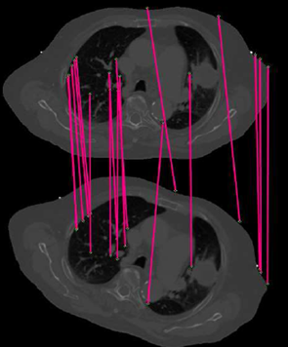
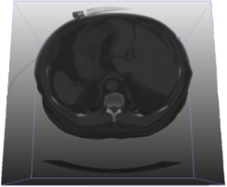
Respiratory Motion Modeling for Lung Tumor Tracking
Developed Medical Image Computing Techniques
Image analysis and Segmentation
Dynamic image registration and tracking
Construct a deforming model that fits the give 4D images accurately for motion analysis and prediction
…
[Xu et al. “Feature-aligned 4D Spatiotemporal Image Registration,” ICPR, pp. 2639-2642, 2012. ]
[Xu and Li, “Consistent Feature-aligned 4D Image Registration for Respiratory Motion Modeling,” ISBI 2013.]

Slide 9
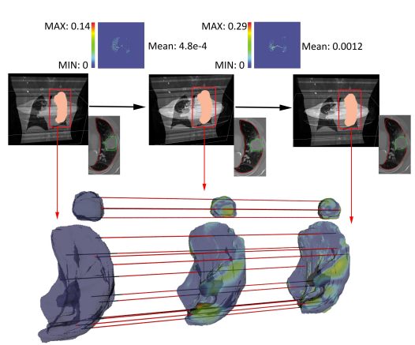
Respiratory Motion Modeling for Lung Tumor Tracking
Developed Medical Image Computing Techniques
Image analysis and Segmentation
Dynamic image registration and tracking
Some Results
Land-mark Prediction Accuracy (error in mm)
Registration error: 0.048% ~ 0.12%
[Xu and Li, “Optimizing 4D Image Registration for Respiratory Motion Modeling,” Submitted to MICCAI 2013].

Slide 10
Respiratory Motion Modeling for Lung Tumor Tracking
Some Results
tracking error $± 1.2 mm$
[Video]
[Xu and Li, “Optimizing 4D Image Registration for Respiratory Motion Modeling,” Submitted to MICCAI 2013].

Slide 11
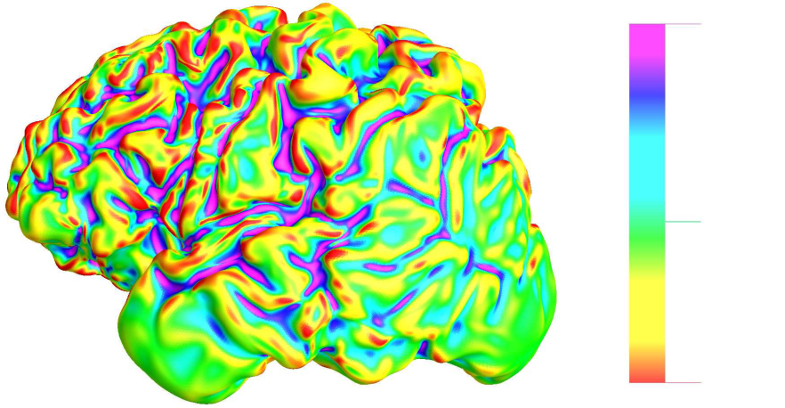
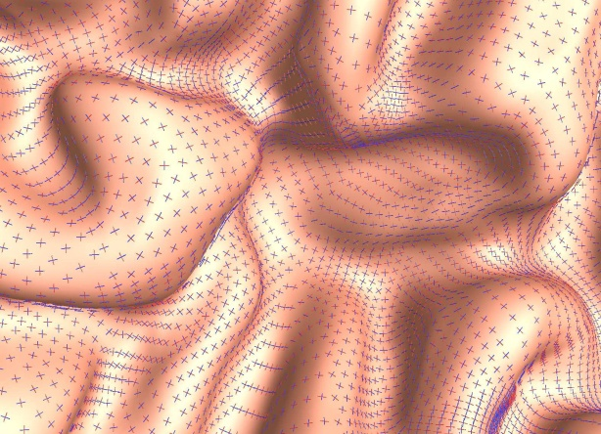
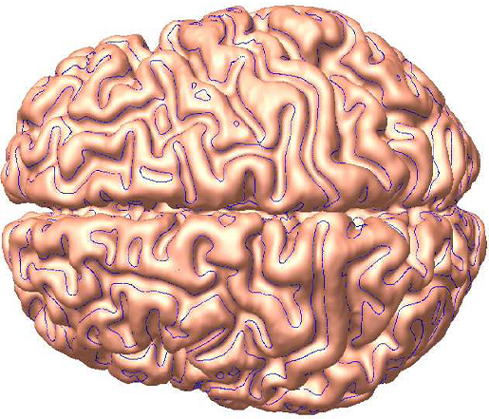
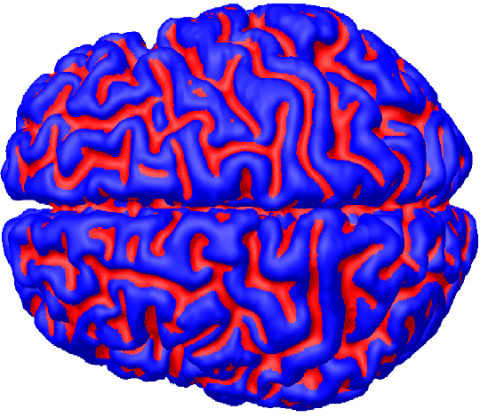
Brain Cortex Analysis and Cross-Subject Comparison
Construct the Spline representation for brain cortex from volume image
A continuous and accurate representation → feature detection and gyri/sulci segmentation
Compared with other state-of-the-art dynamic registration techniques
Feature Detection
Computing Curvature
Principal Directions
[He, Li, Gu, Qin, “Brain Image Analysis using Spherical Splines”, in EMMCVPR05, LNCS, Vol. 3735, pp. 633-644, 2005.]
Registration error: 0.048% ~ 0.12%
Detecting 0-Curvature
Contour
Segmenting Gyri and Sulci

Slide 12
Brain Cortex Analysis and Cross-Subject Comparison
Construct the Spline representation for brain cortex from volume image
A continuous and accurate representation → feature detection and gyri/sulci segmentation
Cross-subject Brain Cortex Comparison
[He, Li, Gu, Qin, “Brain Image Analysis using Spherical Splines”, in EMMCVPR05, LNCS, Vol. 3735, pp. 633-644, 2005.]

Slide 13
Recent Publications Related to Medical Image Analysis
Medical Imaging
Toward More Precise Radiotherapy Treatment of Lung Tumors, IEEE Computer, (45):1:59-65, 2012.
Feature-aligned 4D Spatiotemporal Image Registration, International Conference on Pattern Recognition (ICPR), pp. 2639-2642, 2012.
Consistent Feature-aligned 4D Image Registration for Respiratory Motion Modeling, International Symposium on Biomedical Imaging (ISBI), 2013.
Optimizing 4D Image Registration for Respiratory Motion Modeling, Submitted to Medical Image Computing and Computer Assisted Intervention (MICCAI) 2013
Numerical Optimization on Imaging
Gradient-based methods for sparse recovering, SIAM Journal on Imaging, (4):146-165, 2011.
Bregman Operator Splitting with Stepsize (BOSVS) for Total variation Image Recovering, Computational Optimization and Applications (54):317-342, 2013.
Geometric Data Modeling/Processing
Restricted Trivariate Polycube Splines for Volumetric Data Modeling, IEEE Trans. on Visualization and Computer Graphics (TVCG), Vol. 18, Issue 5, pp. 703-716, 2012
Surface Mesh to Volumetric Spline Conversion with Generalized Poly-cubes, IEEE Trans. on Visualization and Computer Graphics (TVCG), in press, 2013.
Biharmonic Volumetric Mapping using Fundamental Solutions, IEEE Trans. on Visualization and Computer Graphics (TVCG), in press, 2013.
Efficient Spherical Parameterization using Progressive Optimization, Computational Visual Media Conference, pp. 170-177, 2012.

Slide 14
Thank You!
Our research expertise & developed algorithms/software
Geometric and temporal data modeling and processing (motion modeling, pattern detection)
Image processing (image enhancement, segmentation, feature detection, registration/matching)
Numerical Optimization, Algorithms, Geometric Optimization
Goal: to establish collaborations on practical medical problems
Faculty: Xin Shane Li (Computer engineering) : http://www.ece.lsu.edu/xinli
Hongchao Zhang (Math) : http://www.math.lsu.edu/hozhang
PhD Students: H. Xu, S. Wan, W. Yu, K. Zhang
MS Students : M. Chettu, R. Duggapu, S. Kolipaka, R. Kalluru

