Slide 1
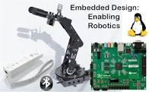
Connecting Computing Education Threads in a Coherent Active Learning Environment
David Kaeli
Amir Momeni, Fritz Previlon, Agamemnon Despopoulos, Gunar Schirner,
John Kimani, Rafael Ubal
Dept. of Electrical and Computer Engineering
Northeastern University
Boston, MA

Slide 2
What are some of the challenges?
Computing is a very broad area of study
Hardware and software typically not addressed in the same course
Transition from theory to practice challenging to present in a chalk-and-talk format
Curricular change is very difficult to accomplish
Key questions:
How can we excite ECE/CS students early on??
How can we connect curricular topics?
How do we avoid teaching a new tool/platform in each new class?

Slide 3
How do we connect concepts?
A systematic sequence of transformations between layers of abstraction
Problem
Software Design:
choose algorithms and data structures
Algorithm
Programming:
use language to express design
Program
Compiling/Interpreting:
convert language to machine instructions
Instruction Set
Architecture

Slide 4
How do we connect concepts?
A systematic sequence of transformations between layers of abstraction
Instruction Set
Architecture
Processor Design:
choose structures to implement ISA
Microarch
Logic/Circuit Design:
gates and low-level circuits to implement components
Circuits
Process Engineering & Fabrication:
develop and manufacture lowest-level components
Devices

Slide 5
Best Practices
Active Learning
Labs
Move traditional labs toward research-based discovery
Classroom settings
Alternative course structures
Introduce the “essence of engineering” early
Presidents Council of Advisors on Science and Technology (PCAST): Engage to Excel (2012)
Discipline-Based Education Research: Understanding and Improving Learning in Undergraduate Science and Engineering, National Research Council, (2012)
National Academy of Engineering Reports, Educating the Engineer of 2020: Adapting Engineering Education to the New Century (2005)
Transformation Is Possible If a University Really Cares. Science, April 19, 2013

Slide 6
A Sucessful Attempt at Connecting Topics
Sophomore students understand connections among a broad range of Electrical and Computer Engineering concepts
Provide early, integrated courses with labs to motivate students, make connections within ECE, help students choose area of focus, and improve coop preparation
Not survey courses, strong ECE content, sophomore year
Provide breadth to the EE and CE curricula
Offer flexibility, including options for alternative semester or summer experiences.
Students can tailor program to interests more easily
Semester abroad or Dialogue or research or other
Build a curriculum that can be modified easily in the future

Slide 7
2014 ECE Curriculum Redesign @ NU
Common first-year engineering program
Need to help sophomores explore Computer Engineering early on
Need to prepare sophomores for their first cooperative work experience
Concerned about sophomore retention – freshman year was too easy, and sophomore year too challenging
Wanted a compelling theme to attract more students to NU and ECE
Build off lessons learned at other programs to understand succesful “Active Learning” approaches
MIT EECS
CMU ECE

Slide 8
BS in EE/CE
2 Capstone
Capstone I
Capstone II
EEs take at least 2 EE technical electives
CEs take at least 2 CE technical electives
ECEs take at least 2 CE and 2 EE electives
ECEs take all 6 fundamentals courses
5 General Electives
EE
CE
Other
Numerical Methods and Comp. App.
Micro and Nano-Fabrication
Electrical Machines
Biomedical Optics
Computer and Telecommunication Networks
CAD for Deign and Test
Subsurface Sensing and Imaging
Semiconductor Device Theory
Electric Drives
Biomedical Signal Processing
Embedded System Design
Parallel and Distributed Computing
Antennas
Biomedical Electronics
Power Systems Analysis
Digital Control Systems
Hardware Description Lang. Synthesis
VLSI Design
4 Technical Electives
Microwave Circuits and Networks
Power Electronics
Wireless Personal Communications Systems
Classical Control Systems
High-Speed Digital Design
Networks
Electronic Materials
Electronic Design
Wireless Communications Circuits
Digital Signal Processing
Microprocessor Based Design
Software Engineering I
Optics for Engineers
Electronics II
Communications
Image Processing and Pattern Recognition
Computer Architecture
Optimization Methods
3EE + 1CE or
3CE + 1EE Fundamentals
EE Fundamentals
of Electromagnetics
EE Fundamentals of Electronics
EE Fundamentals
of Linear Systems
CE Fundamentals Dig. Logic Comp. Organization
CE Fundamentals
of Networks
CE Fundamentals
of Engineering Algorithms
2 Broad Introductory Sophomore
ECE Broad Intro. I
Biomedical Circuits and Signals
ECE Broad Intro II Embedded Design: Enabling Robotics
EEs must have a programming course (AP, Freshman, CE Fundamentals, or other).
2 Freshman Engineering
Freshman Engineering I
Freshman Engineering II

Slide 9
Biomedical Circuits and Signals
Build a working EKG – process signals in Matlab
Covers a little more than half of circuits (some signals material is covered in circuits)
R, L, C, sources, Kirchoff’s Laws
Thevenin and Norton equivalent circuits
Op-Amp Circuits
Phasor Analysis, Filters, Transfer Function
Covers portions of Linear Systems
LTI Systems, Convolution and Impulse Response
CT and DT Fourier Transform
Transfer Functions and Filters
A-2-D Conversion
Biological Component (2 classes)

Slide 10
Embedded Design: Enabling Robotics
Control a robotic arm with 5 servo motors with a Wiimote using both hardware and software
Covers about a third of Digital Design
Combinational and some sequential circuits
Programmable logic (FPGA)
Touches on CMOS and Computer Org
Covers new topics in programming
Goes well beyond freshman C++ programming
Covers data structures and basic algs, and Linux
Covers a small amount of embedded systems design
ZEDBOARD platform provides a common learning platform
Covers both simulation and debugging

Slide 11
CE Fundamentals Courses
Digital Logic and Computer Organization
Most of Digital Logic Design
Benefits from the significant coverage of number systems and combinational logic
Fundamentals of Networks
Most/all of Networks course
Benefits slightly from Bluetooth exposure in Enabling Robotics
Fundamentals of Engineering Algorithms
Most Algorithms course
Benefits from coverage of simple data structs and searching/sorting

Slide 12
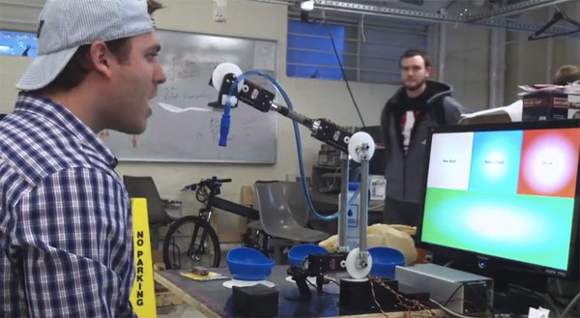
ENABLING ROBOTICS: Class Objectives
Motivated by a capstone design team – an eye-controlled robotic arm to feed a quadriplegic person
Introduce all ECE students to many of the basic elements of Computer Engineering
Provide a hands-on introduction to hardware/software co-design
Build on top of the introductory programming skills developed in earlier programming classes
Introduce the Linux operating system
Prepare students for Computer Engineering fundamentals courses in Digital Design/Org, Networks and Algorithms
Help students appreciate the power of abstraction, while stressing the importance of understanding the underlying theory/concepts to develop an appreciation for the software/hardware interface
Whet their appetites for more Computer Engineering!

Slide 13
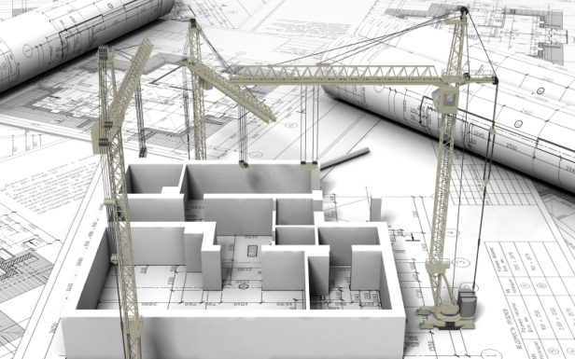
Course Format
Two 65 minute and one 2hr class/laboratory each week
Homework problems develop programming proficiency in 3 languages and digital design skills
Working in the Claboratory will allow us to learn in a hands-on environment with an embedded platform
Robotic and WiiMote elements make the laboratory learning more fun
Implement same elements in both software and hardware
Use of Simulink facilitates HDL synthesis
Pop quizzes help students stay focused on the theory material, and help to encourage prompt attendance

Slide 14
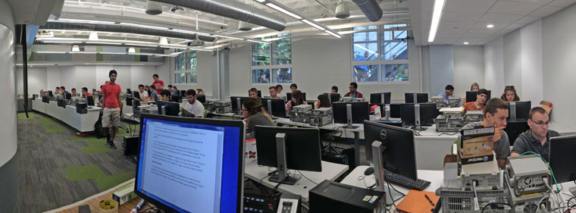
The NU Claboratory
Completely redesigned space fostering active and integrated learning
Students work in teams of two – changing roles each lab
Faculty member, graduate and undergraduate TAs move the lab to assist students with their experiments

Slide 15
Key concepts in this course
Abstraction
A powerful concept, but only if used properly
You should not go off working with black boxes if you don’t know what is inside!!
It is important to understand each component and how multiple components work together
Once understood, then by all means, use the black box
Bottom-up and top-down learning
Learn the CMOS circuit before working with logic gates
Learn data structures and algorithms before jumping into libraries
Hardware vs. Software
Every system has both hardware and software components
The IoT will certainly contain a rich mix of both
Even if you specialize in one area, you should understand capabilities and limitations of both hardware and software

Slide 16
Key concepts in this course
Parallelism and Concurrency
Inherently present in hardware systems
FPGA implementation
Harder to implement in software systems
Different grains of parallelism (task, thread, data)
pThreads
Build experience on an embedded multi-core heterogeneous platform that will be used in future classes
Digital system design and organization
Embedded systems
Computer architecture

Slide 17
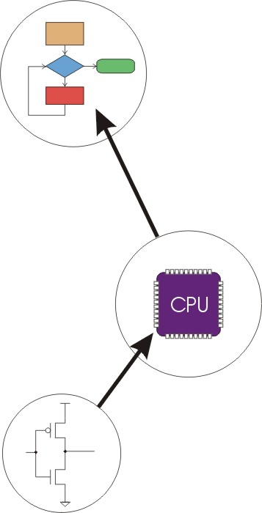
Layers of Abstraction
Problems
Algorithms
Language
Instruction Set Architecture
Microarchitecture
Circuits
Devices

Slide 18
Curricular Coverage
C/C++ programming, some Python
Operating systems - Linux
Digital logic fundamentals – combinational and some sequential
Programmable logic - FPGA
Introductory algorithms – searching and sorting
Debugging – gdb
Design entry and simulation - Simulink
Wireless communication – Bluetooth
Computer architecture – assembly and ISA

Slide 19
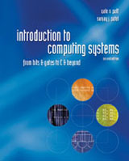
The Textbook
“Introduction to Computing Systems: From Bits and Gates to C and Beyond,” 2nd Edition, Yale Patt and Sanjay Patel, 2003
Presents abstraction elegantly
Starts with transistors and covers all the way to ISAs and HLLs
Can be used in future courses as well
Not perfect – possibly an opportunity for a revision or a new book

Slide 20
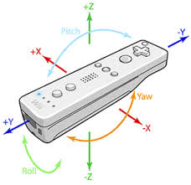
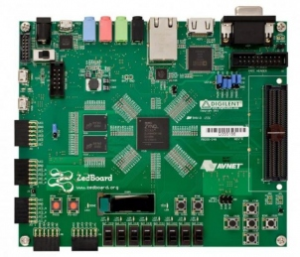
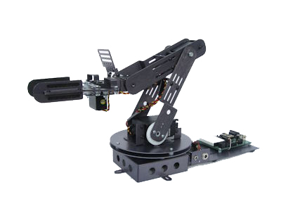
Course – Enabling Robotics
Laboratory Equipment
WiiMote
Buttons
Accelerometers
Robot brain
ZedBoard
Dual-core ARM CPU
Linux
Xilinx FPGA
Buttons, switches, LEDs
Many peripherals and interfaces
Robotic Arm Kit - many choices
Crustcrawler model SG5
5 HiTec servos
Windows PC to run Matlab/Simulink/ssh

Slide 21
ZedBoard
Feature | Description
FPGA | Zynq-7000 AP SoC XC7Z020-1CLG484
I/O Interfaces | USB-UART for programming and serial communication One 10/100/1G Ethernet USB OTG 2.0, USB-UART bridge 12-bit VGA output HDMI Output I2S CODEC Audio Line-In, Line-Out, headphone, microphone
Memory | 512 Mbyte DDR3 256 Mbit Quad-SPI Flash SD card connector
Displays | One 128x32 OLED
Switches and LEDs | 8 Slide switches accessible from PL 8 LEDs accessible from PL, 1 from PS 5 Push-buttons accessible from PL, 2 from PS 1 Reset button accessible from PL, 1 from PS
Clocks | One 100 MHz Oscillator for PL, 33.333 MHz for PS
Expansion ports | One LPC FMC One AMS Header One header for XADC signals 5 Pmod ports

Slide 22
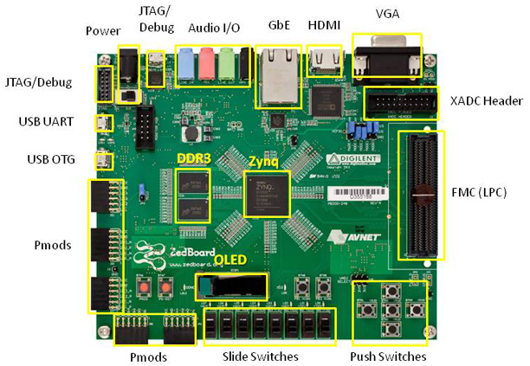
ZedBoard

Slide 23
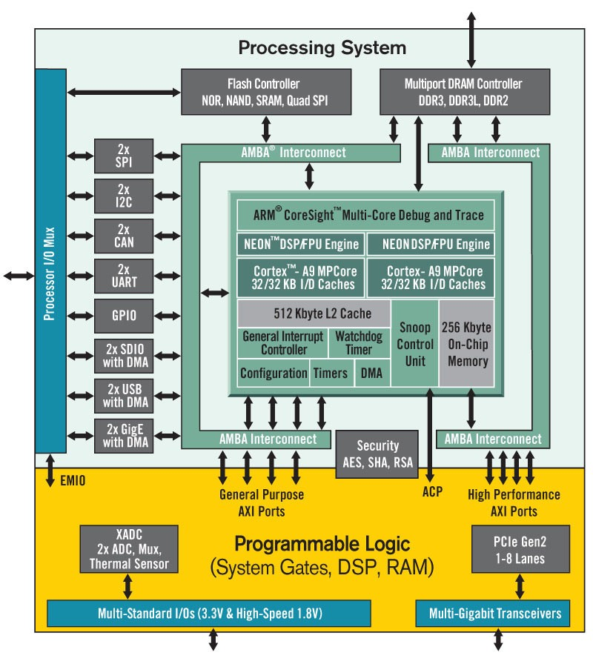
Dual ARM® Cortex™-A9 MPCore™ with CoreSight™
32 KB Instruction, 32 KB Data per processor L1 Cache
512 KB unified L2 Cache
256 KB On-Chip Memory
2x UART, 2x CAN 2.0B, 2x I2C, 2x SPI, 4x 32b GPIO
2x USB 2.0 (OTG), 2x Tri-mode Gigabit Ethernet, 2x SD/SDIO on-chip peripherals
85K logic slices, each with four 6-input LUTs and 8 flip-flops
560 Kbits of fast block RAM
Four clock management tiles, each with phase-locked loop (PLL)
220 DSP slices
Internal clock speeds exceeding 450MHz
2x 12 bit, 1 MSPS On-chip analog-to-digital converter (XADC)

Slide 24
ZedBoard Software
Platform provides xiLinux
xiLinux is a fullblown graphical Linux distribution based upon Ubuntu 12.04
xiLinux includes the Xillybus IP core and driver plus a few other things
Xillybus is a straightforward, portable, intuitive, efﬁcient DMA-based solution for data transport between an FPGA and a host running Linux

Slide 25
Laboratory - Enabling Robotics
Goal: Communicate via wireless with an autonomous robotic arm to carry out a set of tasks
Each lab experiment has an accompanying prelab that is submitted before starting of the lab
Lab 0: Introduction to Linux and the ZedBoard – write your first C program
Lab 1: More work with Linux – write programs that utilize 2’s complement
Lab 2: Introduces debugging – debug buggy programs with gdb
Lab 3: Introduces memory-mapped I/O – read and write to switches and LEDs on the ZedBoard
Lab 4: Introduces Bluetooth using the WiiMote – reverse engineering the WiiMote commands on the receiver – control the LEDs on the ZedBoard with the WiiMote accelerometer

Slide 26
Laboratory - Enabling Robotics
Lab 5: Introduction to Simulink – enter a design in Simulink and simulate the design
Lab 6: Continue with Simulink – develop a more sophisticated design in Simulink to use the FGPA to interface between ZedBoard switches, buttons and LEDs
Lab 7: Learn about pulse-width modulation – use a C program to control the robotic arm
Lab 8: Robotic control – revisit the designs developed in Labs 6 and 7 to control the robotic arm with the FPGA
Lab 9: Hardware/software codesign – read commands from the WiiMote through C programming, and control the robotic arm with the FPGA – carry out a set of tasks

Slide 27
Other elements - Enabling Robotics
Bi-weekly homeworks on:
Number systems
Simple data structures – structs, linked lists, queues, stacks
Object oriented design – polymorphism, encapsulation, inheritance, overloading
Digital design – combinational and FSMs
Microarchitecture - adders
LC3
Simulink as a synthesis/simulation tool
Paper
Design choices (hardware and software) for a next generation robotic vacuum
Lab revision
Revise a specific lab report based on feedback received
Design your own lab experiment

Slide 28
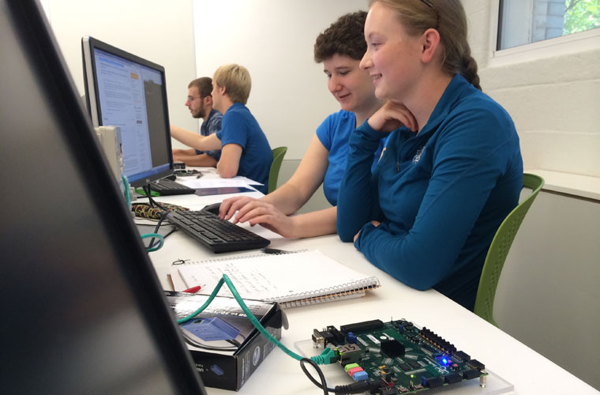
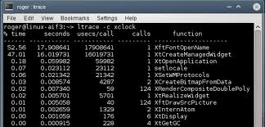
Course – Enabling Robotics
Learning outcomes:
Students should understand the basics of combinational and sequential logic design
Students should have an appreciation for algorithm design
Students should develop strong skills in C/C++ programming
Students should understand how wireless devices communicate
Students should gain an appreciation for simulation, debugging and documentation

Slide 29
Student Projects
The Drawing Arm
Sign and Morse Interpretation
Project Snake
The Wiibot

Slide 30
Student Feedback
“I learned so much in this course. I came in knowing a small amount of C, and I came out experienced in C, C++, the Unix operating system, and Simulink. I also learned a good deal about the basics of computer architecture, PWM signals, and Bluetooth.”
“Embedded Design packs an incredible amount of information into one semester. It is a lot of work, but it’s definitely manageable.”
“The course is really successful in its ability to provide the basic idea of what it is that a Computer Engineering student does and I am now ready to take the computer fundamentals classes.”
“…. Also, we programmed robots, that was cool!”

Slide 31
Changes to the course
Wiimote vs. Dataglove
Simulink tutorial
More open lab time
Leverage Zedboard in future classes
All ECE and CCIS majors are required to take the class
Nicely supports the new CE/CS combined major
An increasing number of first-year students are taking this class – great attracter to CE!

Slide 32
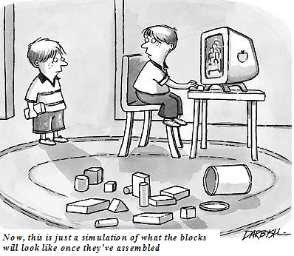
A closing thought!

Slide 33
Questions?
Thanks to our sponsors:
David House Foundation
Mathworks
Xilinx

