Slide 1
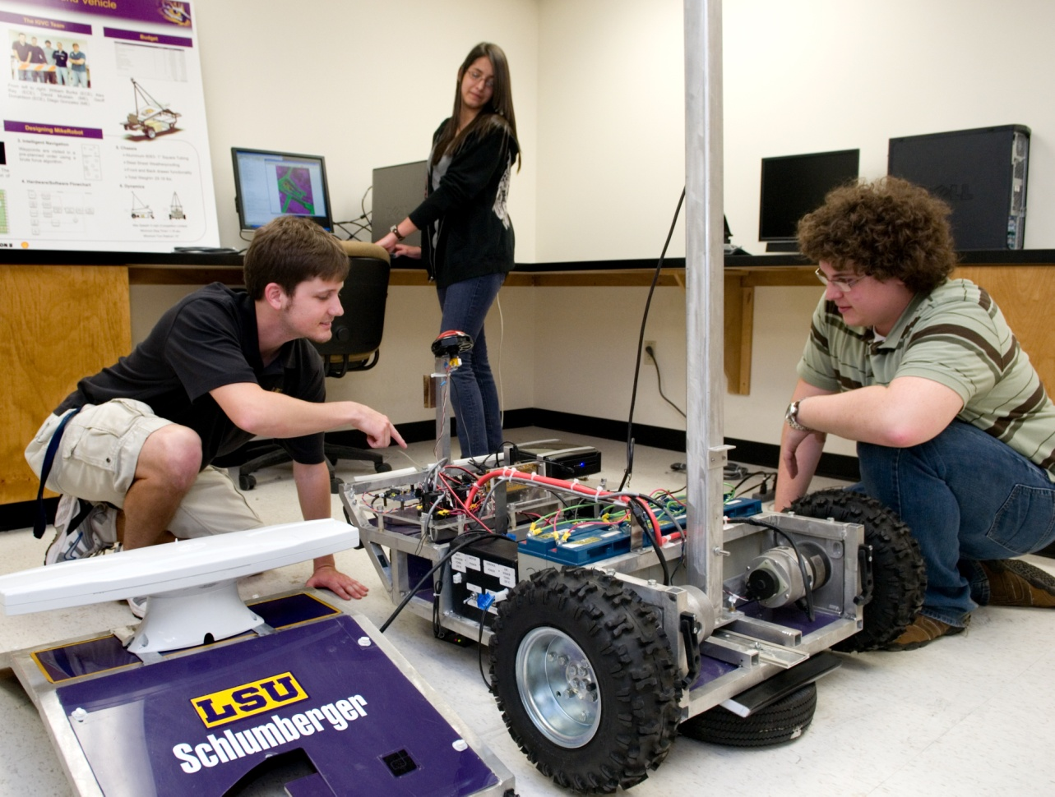
www.ece.lsu.edu
Electrical Engineering
Computer Science
Computer Engineering
Presented by:
John Scalzo, Undergraduate Adviser and Instructor
School of Electrical Engineering and Computer Science

Slide 2
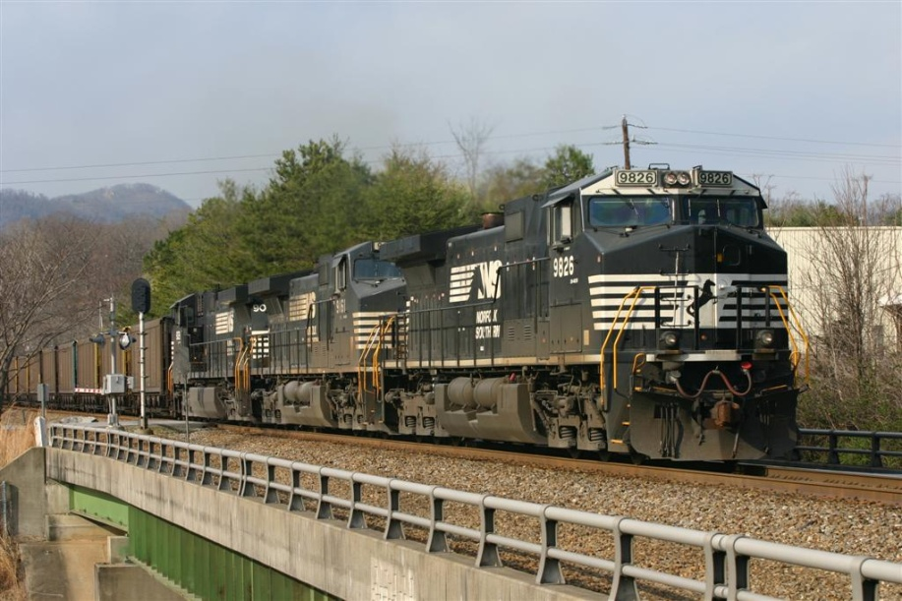
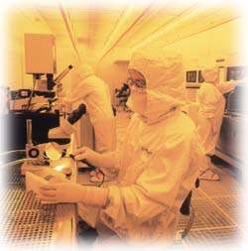
My career in EE:
IEEE
HKN
Co-Op
EIT

Slide 3
Isn’t engineering just for the guys?

Slide 4
Is Engineering worth it?
Average Starting Salaries for Spring 2012
Data from NACE Spring 2012 Salary Survey
NACE reported a 0.4% decrease in Engineering Salaries from 2011 to 2012
http://education.yahoo.net/articles/top_5_in-demand_degrees.htm?kid=1H68V

Slide 5
LSU students are getting paid at or above the national average.
Data from NACE Salary Survey Spring 2012
NACE reported a 0.4% decrease in Engineering Salaries from 2011 to 2012
2012 Spring Only

Slide 6
Computer Engineering Students at Graduation

Slide 7
Electrical Engineering Students at Graduation

Slide 8
Companies Offering ECE undergraduates
US Naval and Space, CA
Motorola, LA
Entergy (3), LA, MS
Halliburton (2), OK
Dow Chemical, LA
BP Amoco (2), TX
Schlumberger, AR
United States Navy
United States Marine Corps
Georgia Pacific, GA
Sensus, LA
Audubon, LA
Argos Acquisitions, LA
Microsoft, NC
Exxon-Mobil, TX
Eaton Corp. (2), WI
Konsberg Maritime (10), LA
Albermarle (2), TX
Oncor Electric (2) , TX
ILD, LA
Odom Hydrographics, CA
Enercon, LA
SPAWAR, CA
American Airlines, TX
Sparkfun Electronics, CO
Arkel Int. , LA

Slide 9
Companies Offering ECE undergraduates
Universal Pegasus Int., TX
KGP Logistics, LA
AWC Inc, LA
BR Marine Electric, LA
RJE Telecom, LA
RBA Engineers, AK
Shell
Petrotech, LA
Shaw, Baton Rouge
Baker Concrete, NM
Fluer, Houston
GSE, Houma
Cimation, New Orleans
Lyondell, Houston
Dashiellm Houston
American Airlines, Dallas
Cameron, Houston
C&C Technologies, Lafayette
Trident Group, Virginia Beach
CGI, Baton Rouge
General Electric, Shreveport
Barowka &Bonura Engineers and Consultants, LA

Slide 10
Companies Offering by State
23 Louisiana
23 Out of State
Out of state Breakdown:
13 Texas
California
1 each AK, AR, CO, FL, NC, NM, VA

Slide 11
Graduate Schools accepting ECE undergraduates
Georgia Tech
U of Pittsburgh
Duke – Law
Michigan – Law
U of Washington – Law
Tulane – Law
LSU – Law
UNO
Virginia Tech
Auburn
Southern Cal
NC State
U of Colorado
Vanderbilt
Texas A&M
University of Florida
Cornell
UT Austin
Washington U – St. Louis
Ohio State
LSU
UC San Diego
UC Irvine
UC Davis

Slide 12
Areas of Electrical Engineering
Electronics
Power
Computers
Communications
Signal Processing
Controls
Electromagnetics

Slide 13
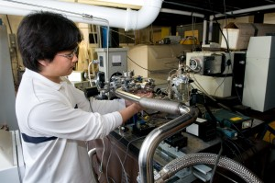
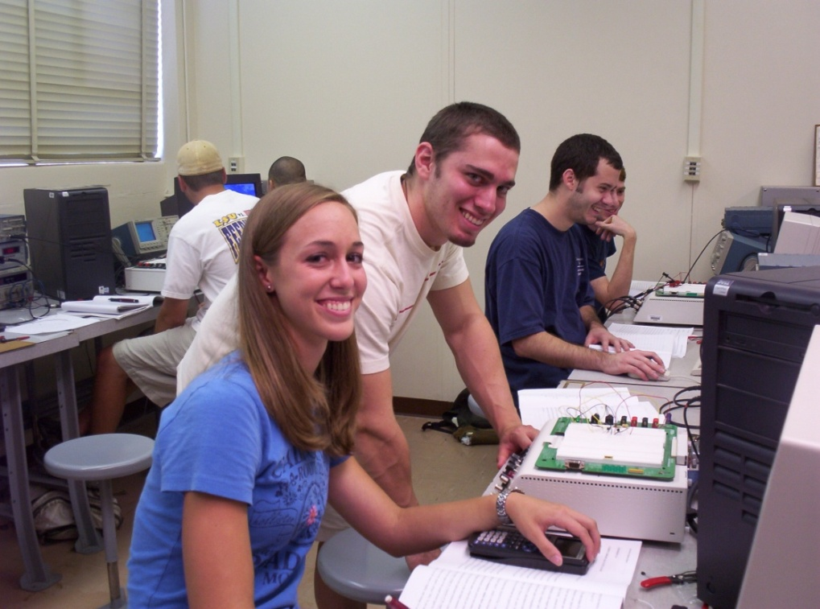
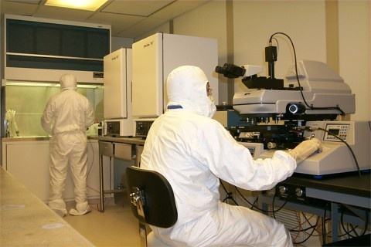
Areas of Electrical Engineering
Electronics – semiconductor devices, materials, nano electronics, integrated circuits, VLSI
Electronic materials and device laboratory

Slide 14
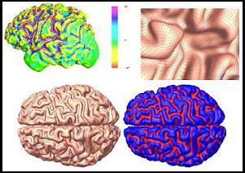
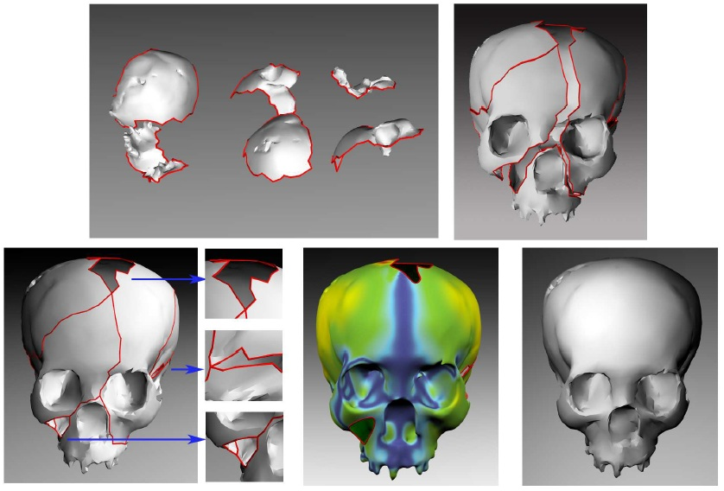
Areas of Electrical Engineering
http://www.ece.lsu.edu/
Computer – Hardware or Software, game theory
Brain image analysis using spherical splines Ying He, Xin Li, Xianfeng Gu, and Hong Qin
An Automatic Assembly and Completion Framework for Fragmented Skulls
Zhao Yin, Li Wei, Xin Li

Slide 15
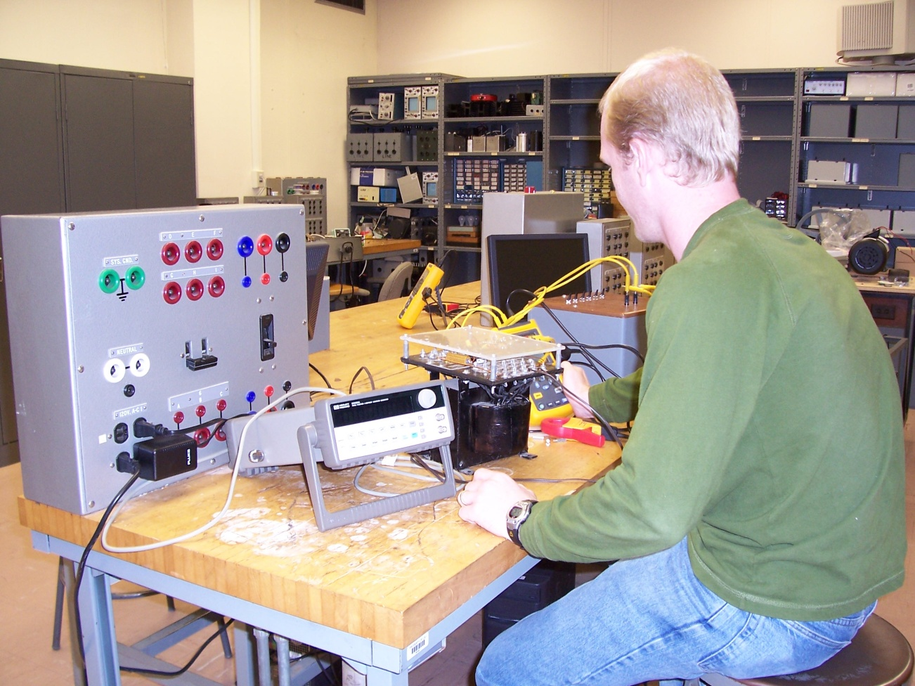
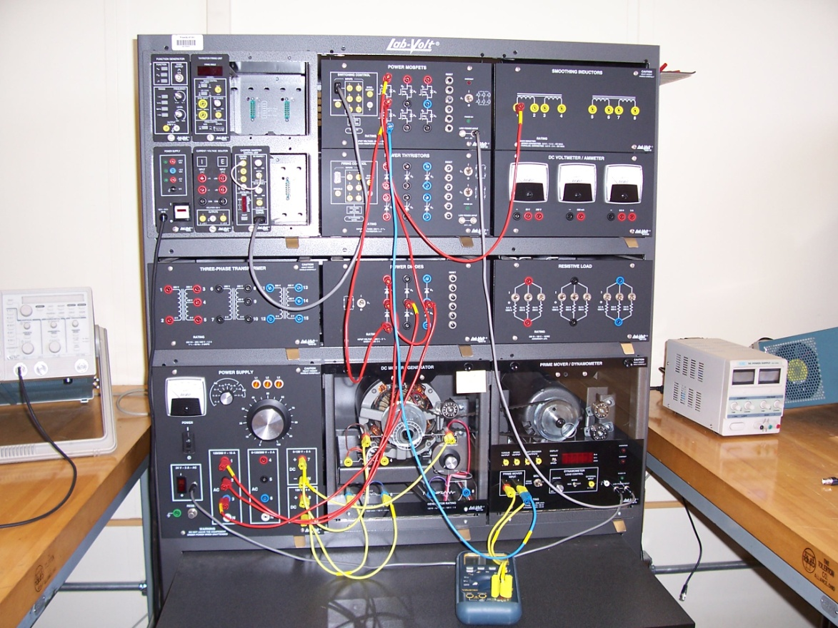
Areas of Electrical Engineering
Power – Distribution, motors and machines, drives, power system protection and control, power electronics

Slide 16
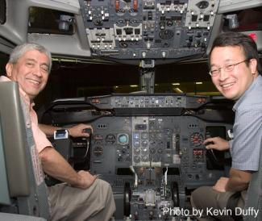
Areas of Electrical Engineering
Controls – automatic process control, digital controls, manufacturing, chemical production, refinery
Dr. Aravena and Dr. Kemin Zhou are working with NASA to develop new technology to prevent airplane failures.

Slide 17
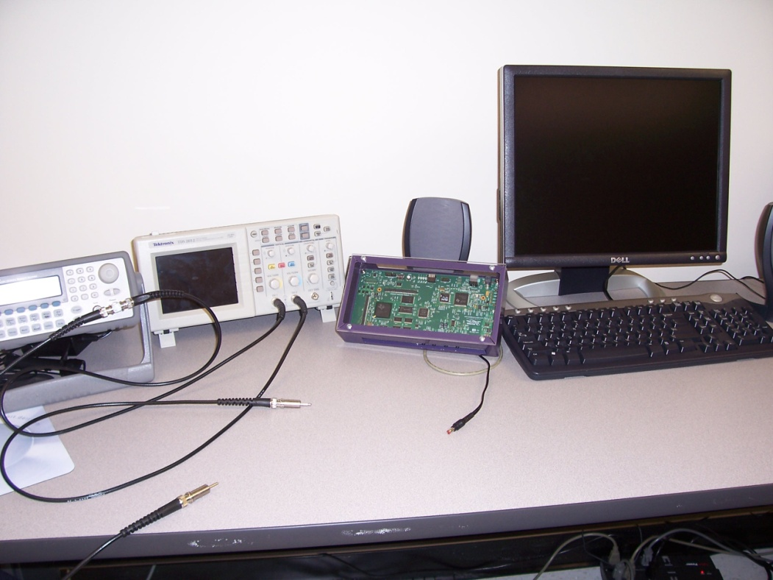
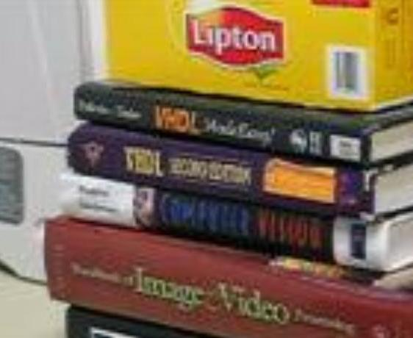
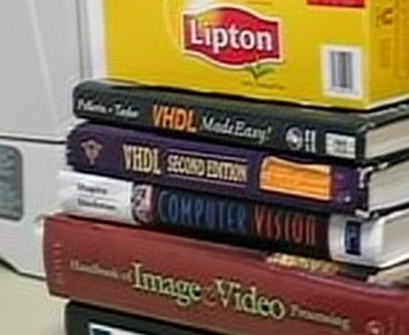
Areas of Electrical Engineering
Communications/Signal Processing – analog and digital communications, DSP, coding, encryption, data compression and transmission – video, speech, imaging, sound engineering
Image Enhancement
Original Image
Super Res - Image

Slide 18
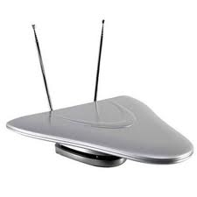
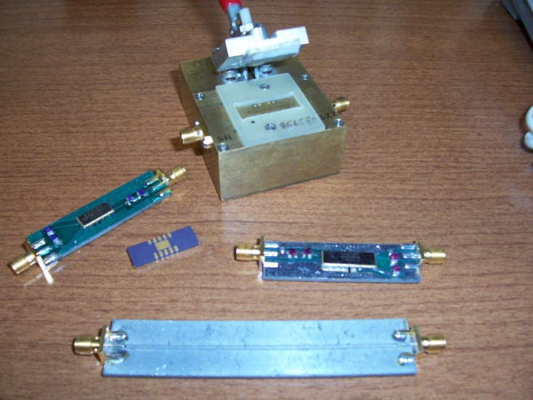
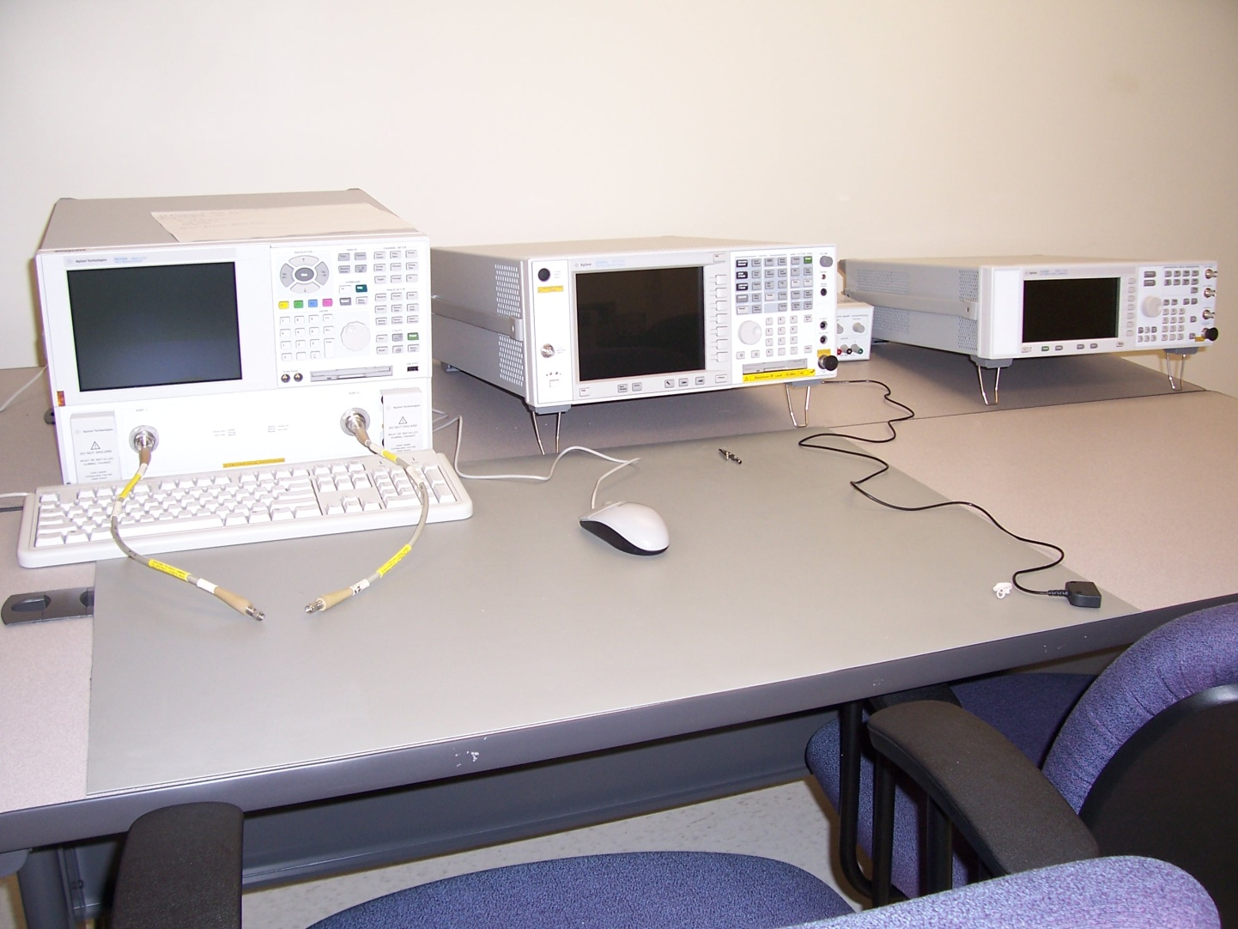
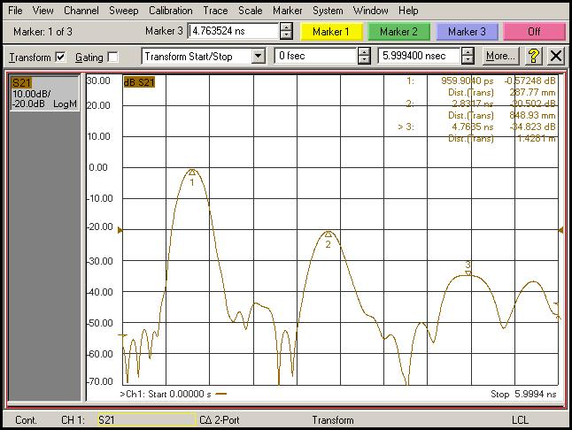
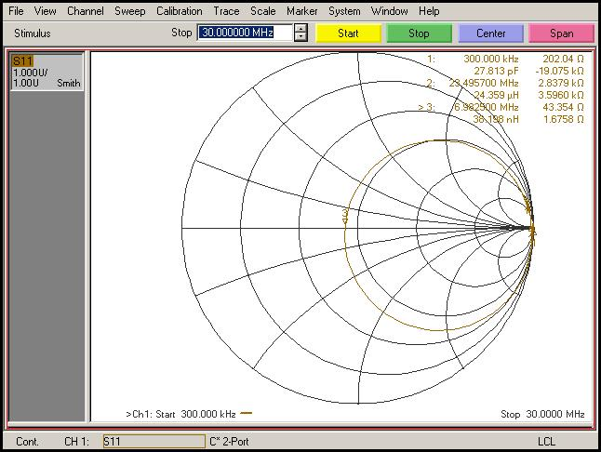
Areas of Electrical Engineering
http://www.ece.lsu.edu/
Electromagnetics – RF propagation, Microwave devices, wireless systems, RFID’s, GPS

Slide 19
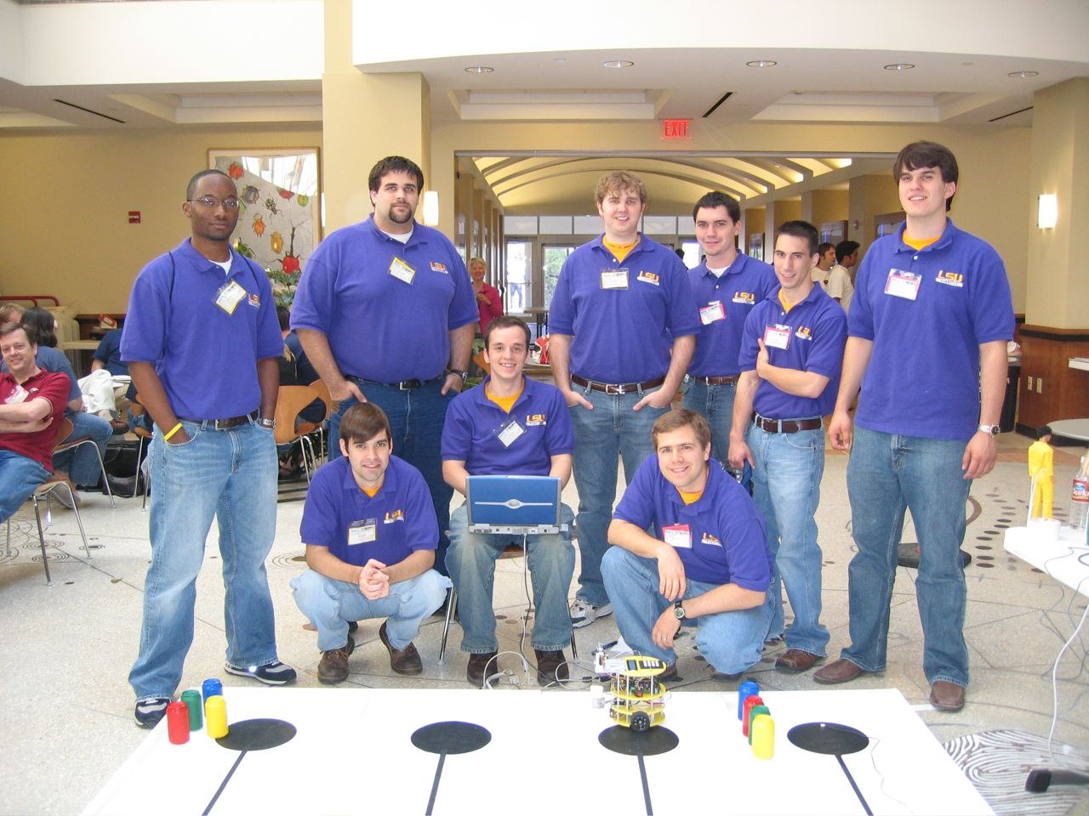
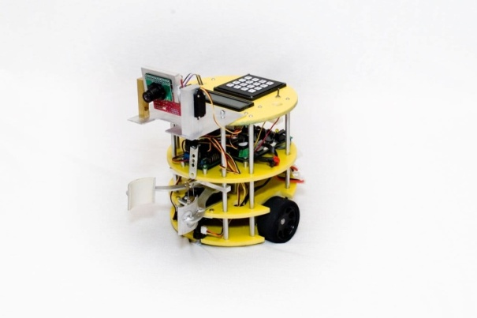
Electrical Engineering
IEEE Region V Robotics Competition
2nd of 32 in 2006, 1st Place 2004 & 2005
Courtesy of LSU IEEE 2006
IEEE Robotics Team 2006
Philip Ducote
Greg Domingue
Drew Barbier
Jason Goleman
Scott Padgett
Ryan Arbour
Brandon Nason
Justin Price
Mariel Losso

Slide 20
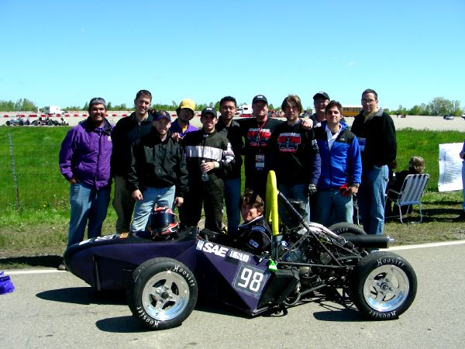
Mechanical & Electrical Engineering
SAE Formula I (Mini Indy) 2006, Pontiac MI
65th of 125, ME & EE
SAE Mini Indy Team 2006
Leroy Blanchard
Ray Malek
David Allison
Corey Dufrene
Paul Janeski
Amy Kreutz
Blake Manuel
Kevin Naquin
Brian Seiler
Jacob Porta
Jaspreet Bains
Kasey Adams
Advisors:
Dr. Keith Gonthier
Dr. Eyassu Woldesenbet
Courtesy of LSU Mini Indy 2006

Slide 21
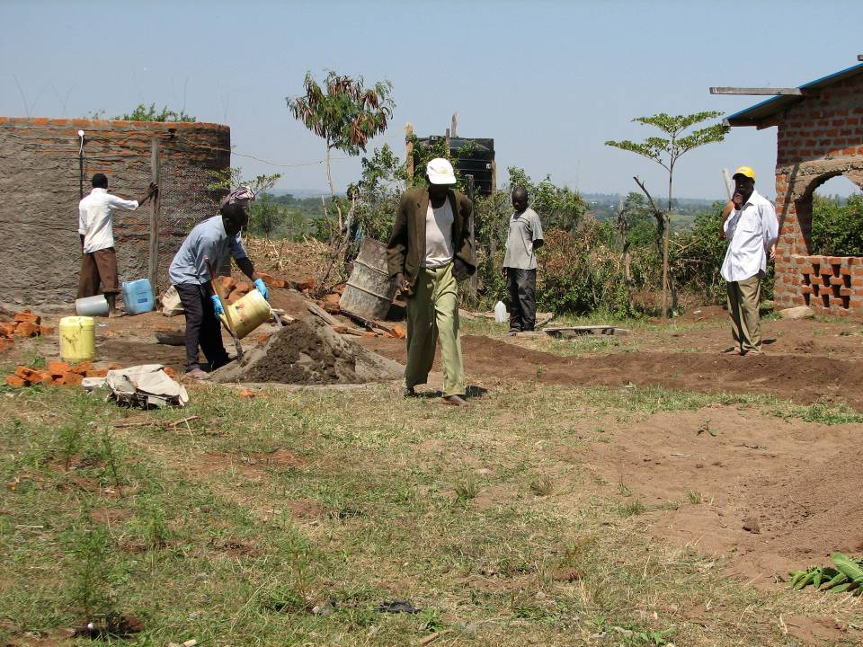
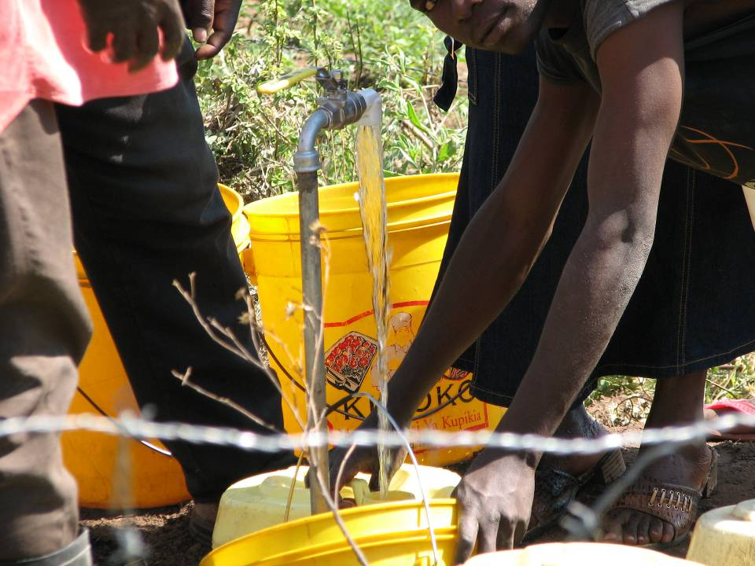
Engineers Without Borders
Drinkable water supply for village of Nyamilu, Kenya
Multidisciplinary Group of Students
Joint Project w/ Darmouth
EWB Team 2006
Andrew Bankston - CEE
Chris Bergeron - ARCHI
James Dupree - ME
Blake Lemoine - EE
Leah Lemoine - CEE
Rachel Stich - CEE
Elaine Tate - CEE
David Hawley - CEE
Nathan Carse - CEE
Steven Cook - CEE
Meghan Grant - CEE
Michael Griffith - CM
William Lopez - CHE
Jenifer Placide - BE
Justin Pugh - EE
Advisors:
Dr. Bill Moe
Al Pawlowski
Courtesy of LSU EWB Team, 2006
Notes:
First project for LSU EWB chapter. Joint with Dartmouth College to put in drinking water system for village of Nyamilu Kenya. Dartmouth went beginning of summer 2005 and put in well with pump and small temporary storage tank. LSU was supposed to go late summer 2005 to put in distribution system and permanent storage tank. Trip delayed until summer 2006 causing many of the LSU EWB students that worked on the fund raising and design to not be able to make it; graduations, summer jobs etc. James Dupree and I went this summer and supervised the installation of a new pump, to get deeper water, basic distribution piping and construction of 30,000 liter brick storage tank (~12ft diam by 10ft high). Work/project was big success. Lots done in short (~15 day) time period. LSU EWB chapter hopes to be able to raise funds for expanding the system in the future. I believe the experience was an invaluable piece of education in what engineering is all about i.e. building/construction.
Students belonging to LSU Engineers Without Borders and working on the project at one time or another during the last two years.
Andrew Bankston - CEE Chris Bergeron - ARCHI James Dupree - ME
Blake Lemoine - EE Leah Lemoine - CEE Rachel Stich - CEE
Elaine Tate - CEE David Hawley - CEE Steven Cook - CEE
Nathan Carse - CEE Meghan Grant - CEE Michael Griffith - CM
William Lopez - CHE Jenifer Placide - BE Justin Pugh - EE

Slide 22
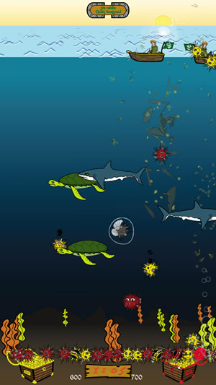
Minor in Digital Media LSU Students Apply Cutting-Edge Creativity, Interactive Techniques to Develop Original Video Games
AVATAR, a multidisciplinary initiative at LSU creating new research areas in virtual environments, digital art, electroacoustic music, animation, video game design, scientific visualization and more.
Participating Departments – ECE, Art, CSC, ENGL, Mass Comm, Music, CCT

Slide 23
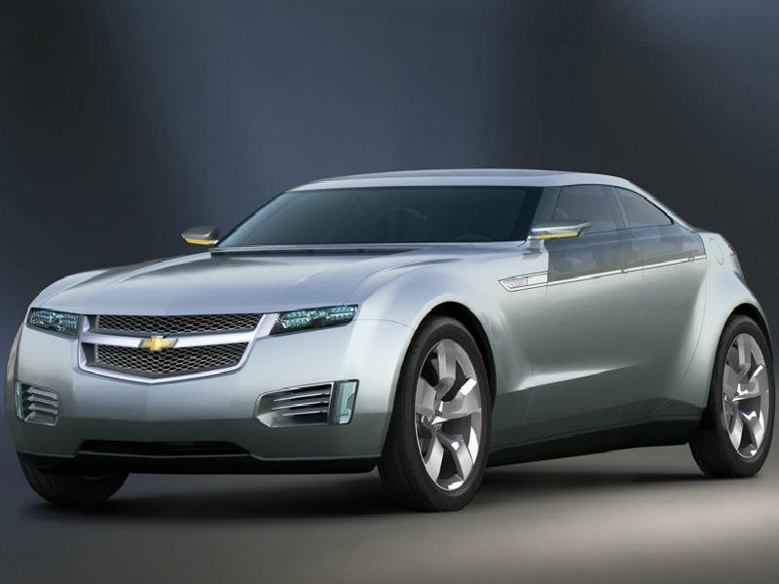
Latest achievements in electrical and computer engineering to hit the market?
4 G Wireless
Tablet computers
Viruses coated with conductor material used as connections in nanoelectronics
High resolution deep space imaging
Extraterrestrial robots - Curiosity
Compressed digital/audio – MP3
GPS implants for cars, people!
High performance graphics processors for gaming
Increase in sales of electric cars

Slide 24
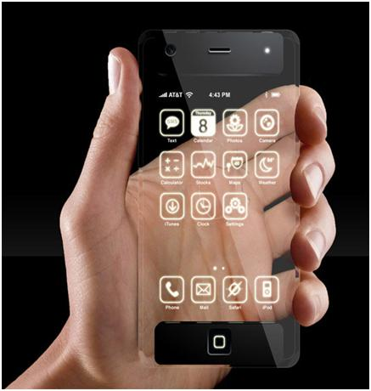
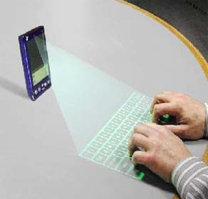
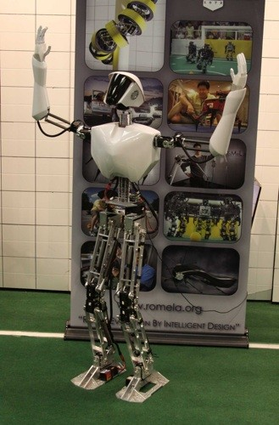
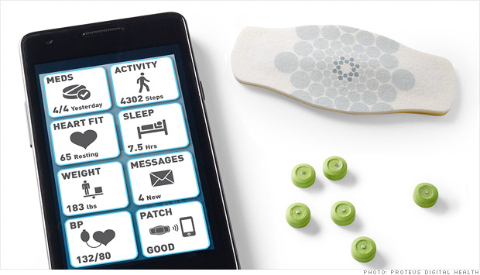
What’s Next ? YOU DECIDE!!
Notes:
CHARLI is the first untethered, autonomous, full-sized, walking, humanoid robot with four moving limbs and a head, built in the United States. His two long legs and arms can move and gesture.
Proteus- maker of pills with microchips that transmits data to a patch worn on the skin, which communicates with a smartphone app.

Slide 25
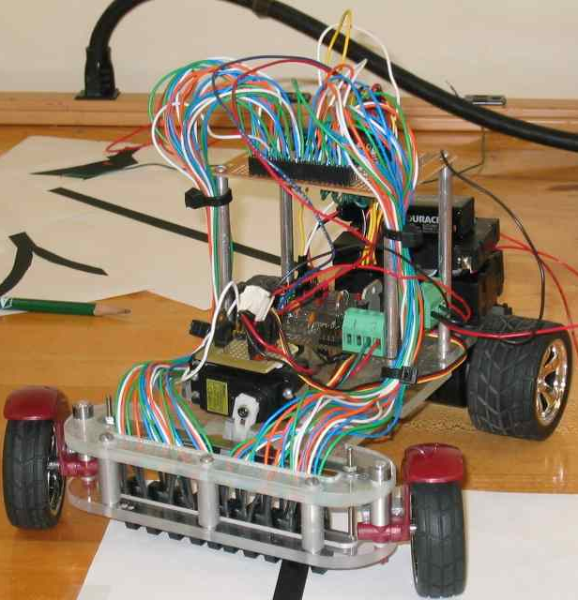
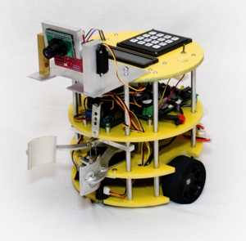
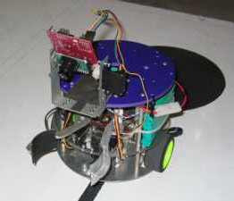
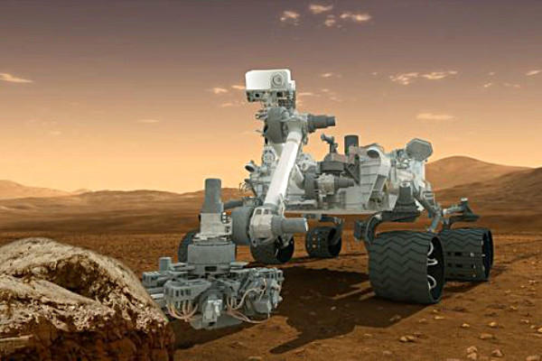
What are ECE students doing?
Designing these robots……
Could lead to designing this one!
http://www.youtube.com/watch?v=xQObuxnfFe8

Slide 26
Tech Trends Part 1
http://www.youtube.com/watch?v=x_l7ddt9S-8
Tech Trends Part 2 - Sensors
http://www.youtube.com/watch?v=pBi0oDZ8p64
Tech Trends Part 3 - Robotics
http://www.youtube.com/watch?v=1erPar_PiLY
CHARLI
http://www.youtube.com/watch?v=k1Dz5mFpVxA

